Slide 1

ALICE 13TeV
$\frac{1}{N_{trig}}\frac{d^{2}N_{pair}}{dΔηdΔφ}={\left.B\left(0,0\right)\frac{S\left(Δη,Δφ\right)}{B\left(Δη,Δφ\right)}\right|}_{p_{T, trig} , p_{T, assoc}}$ (3.1)
$\frac{1}{N_{trig}}\frac{dN_{pair}}{dΔφ}=\int_{1.6<\left|Δ η\right|<1.8}{\left(\frac{1}{N_{trig}}\frac{d^{2}N_{pair}}{dΔηdΔφ}\right)\frac{1}{δ_{Δη}}dΔη −C_{ZYAM}} (3.2)$
$δ_{Δη}=2×\left(1.8−1.6\right)=0.4 →$ normalization factor
$Y^{ridge}=\int_{\left|Δ φ\right|<\left|Δ φ_{min}\right|}{\frac{1}{N_{trig}}\frac{dN_{pair }}{dΔφ}dΔφ} (3.3)$
The minimum yield($C_{ZYAM}$) at $Δφ=Δφ_{min}$
Near-side : $\left|Δ φ\right|<1.28 →$(3.4) 위
$Y^{near} →$near-side jet-like peak yield

Slide 2

CMS, ALICE
Long-range : ALICE $→ 1.6<\left|Δ η\right|<1.8$
CMS $→ 2 <\left|Δ η\right|< 4$
High multiplicity : ALICE $→0\sim 0.1\%$
CMS $→ N_{trk}^{offline}≥105 →0\sim 0.03\%$
지금까지 CMS의 $Δ φ$ Correlation을 그릴 때에, 그냥 적분을 하였음.
ALICE의 (3.2)의 식을 이용하여 적분하여 다시 그려봐야 함.($δ_{Δη}$)
CMS의 $C_{ZYAM}$은 있지만, ALICE는 $C_{ZYAM}$이 없어 $1<p_{t}<4을$ 그릴 수 없음.

Slide 3

현재 계산식
$Δφ$Correlation : $\frac{1}{N_{trig}}\frac{dN_{pair}}{dΔφ}=\int_{1.6<\left|Δ η\right|<1.8}{\left[\int{\left(\frac{d^{2}F}{p_{T}dp_{T}dΔηdΔφ}\right)}\frac{1}{δ_{Δη}}p_{T}dp_{T}\right]dΔη −C_{ZYAM}}$
$p_{T}$Distribution : $Y^{ridge}=\int_{−1.28<\left|Δ φ\right|<1.28}{\left[\int_{1.6<\left|Δ η\right|<1.8}{\left(\frac{d^{2}F}{p_{T}dp_{T}dΔηdΔφ}\frac{1}{δ_{Δη}}dΔη\right)}\right]dΔφ }$
$Y^{ridge}=\int_{−1.28<\left|Δ φ\right|<1.28}{\left[\int_{1.6<\left|Δ η\right|<1.8}{\left(\int{\frac{d^{2}F}{p_{T}dp_{T}dΔηdΔφ}} p_{T}dp_{T}\right)\frac{1}{δ_{Δη}}dΔη}\right]dΔφ }$
이렇게 실험데이터와 동일하게 $p_{T}=1.25 →1.<p_{T}<1.5$ 구간을 적분해서 포인트 처리를 해야 할 수도?

Slide 4

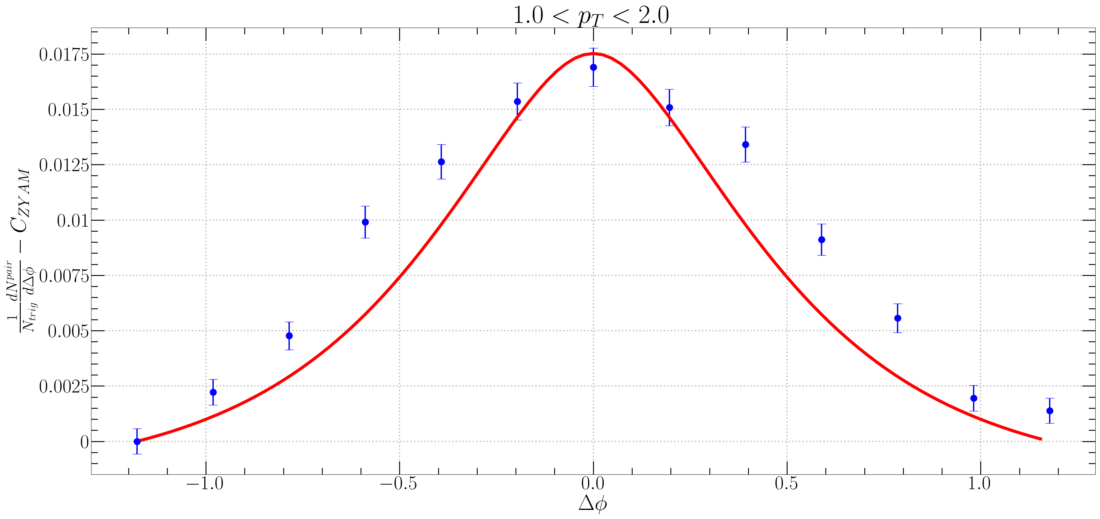

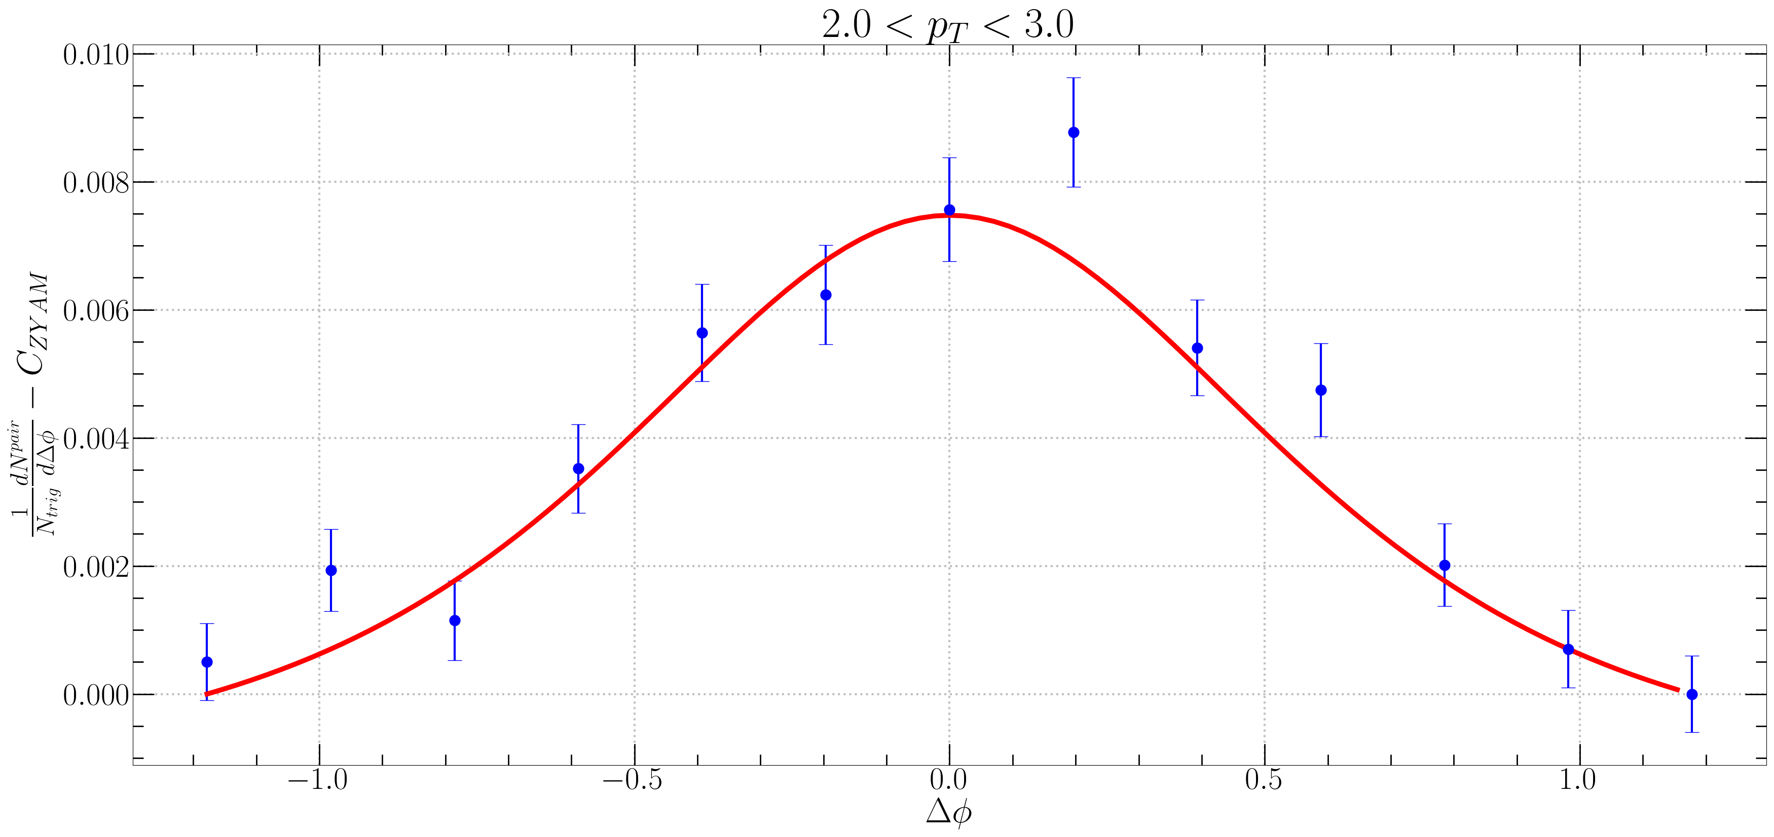


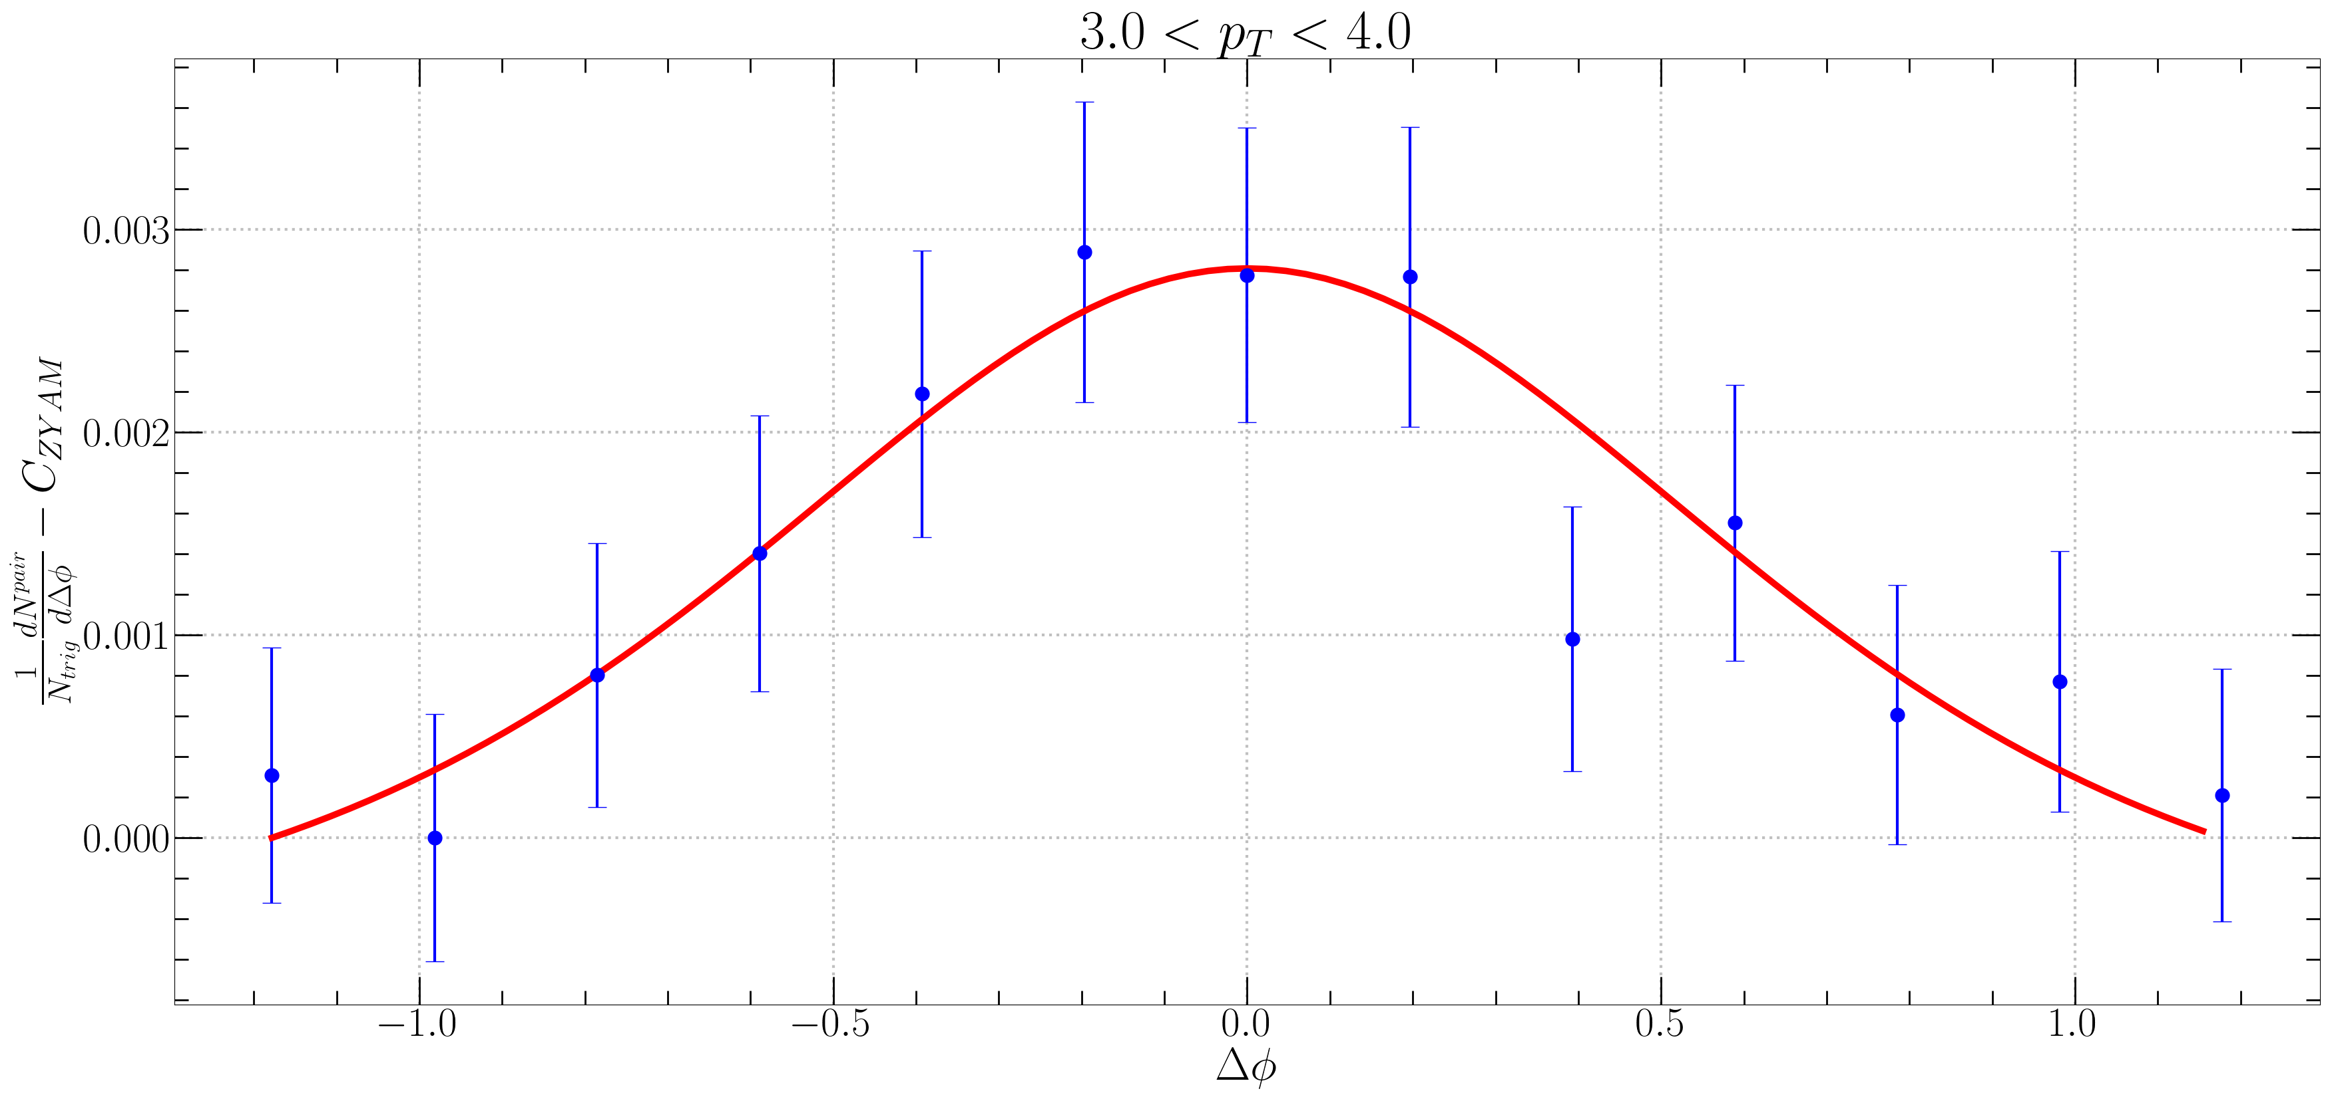

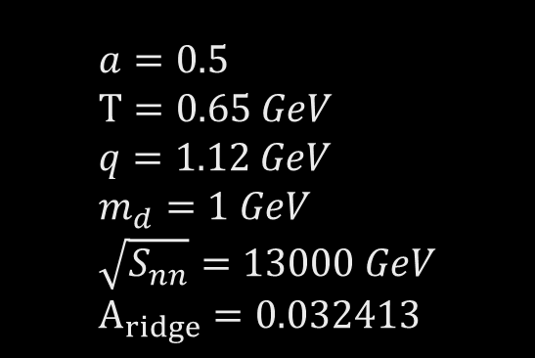


$$a=0.5 \\ T=0.65 GeV \\ q=1.12 GeV \\ m_{d}=1 GeV \\ \sqrt{S_{nn}}=13000 GeV \\ A_{ridge}=0.032413$$
$Δφ$ Correlation Fitting 1
in ALICE
$f_{R}<N_{k}>$ $1<p_{T}<2 →1.2$ $2<p_{T}<3 →2$ $3<p_{T}<4 →4$

Slide 5
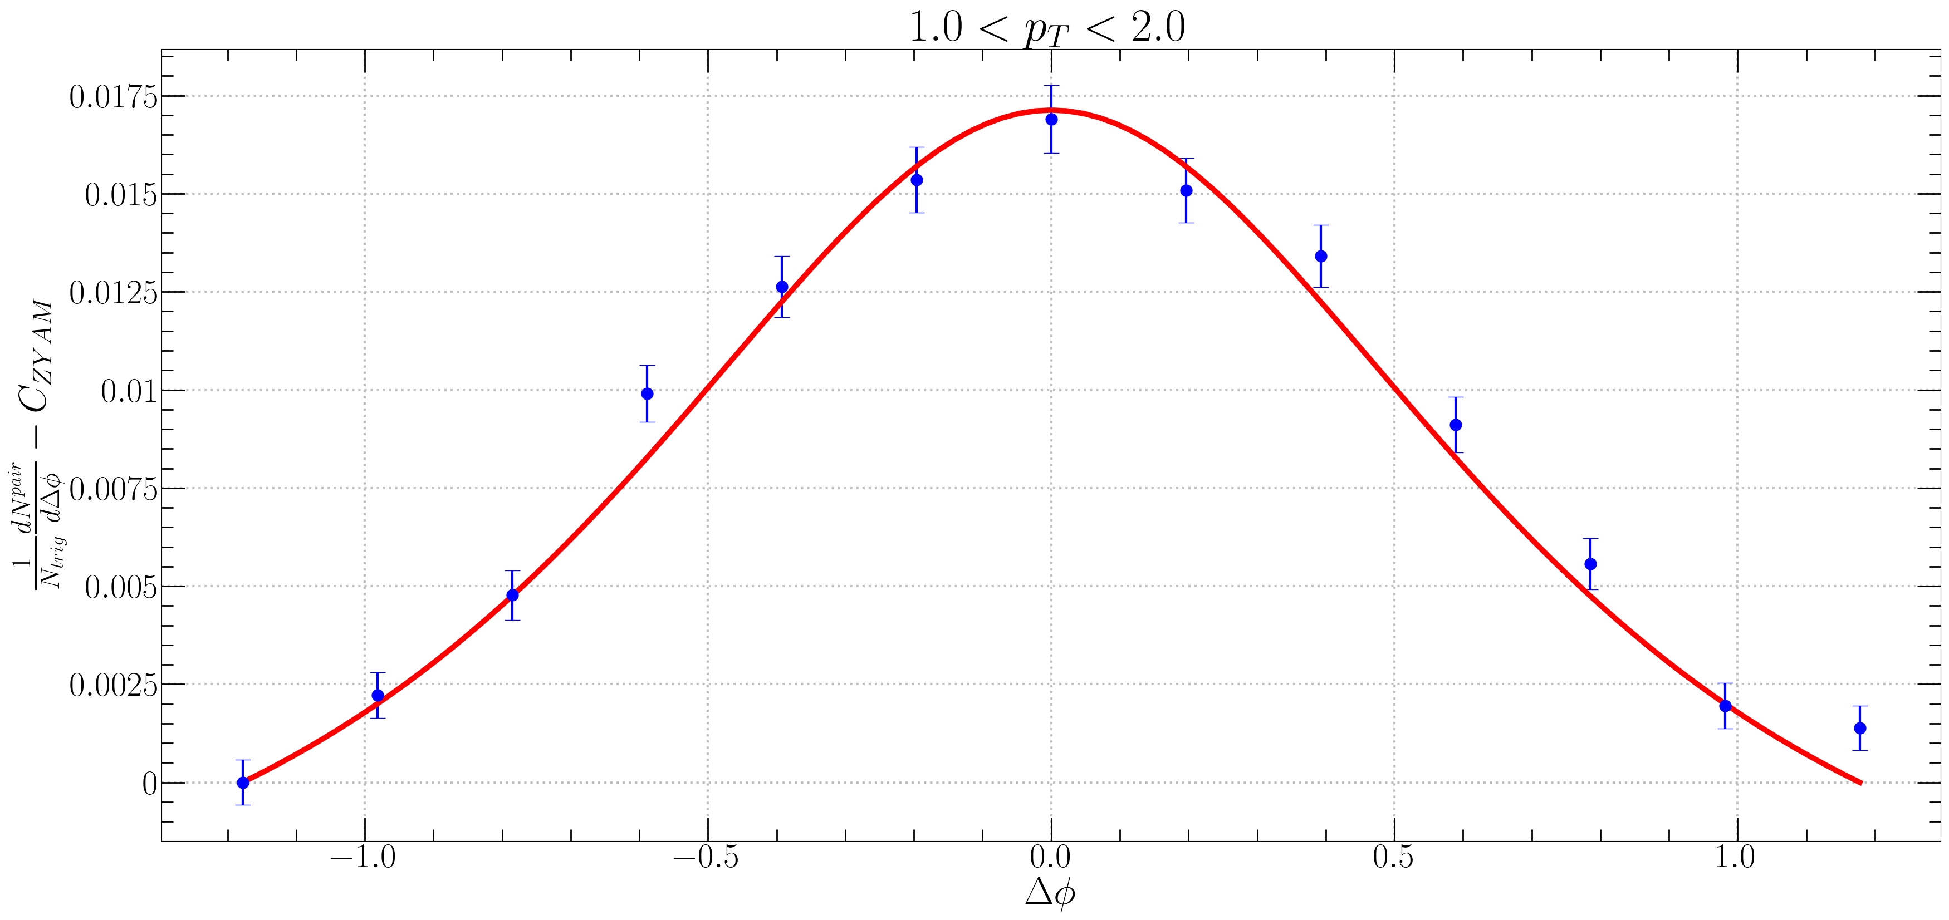
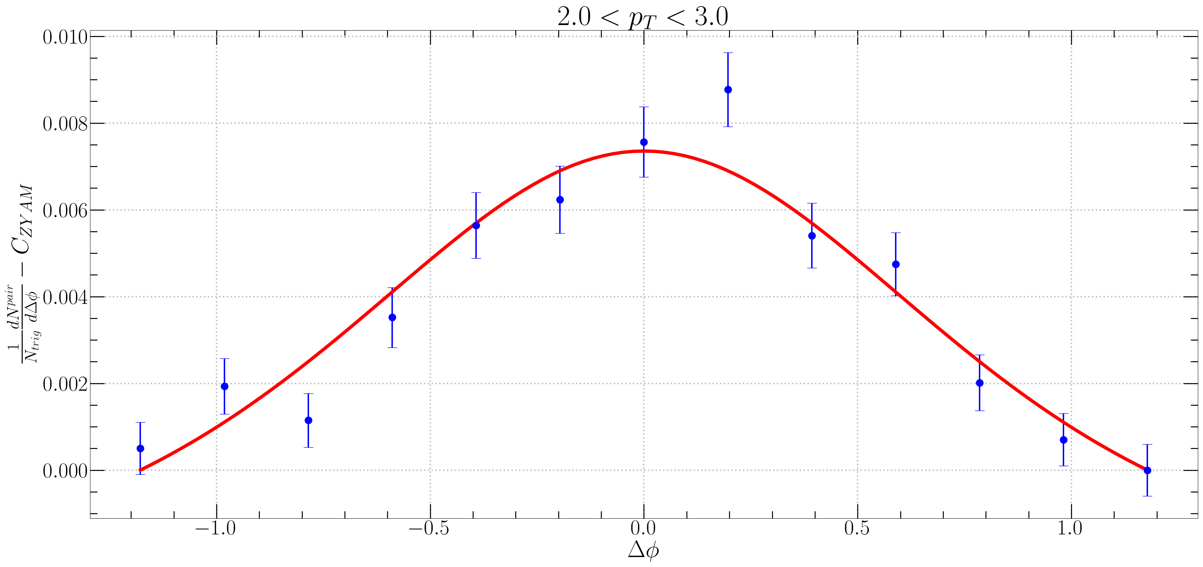
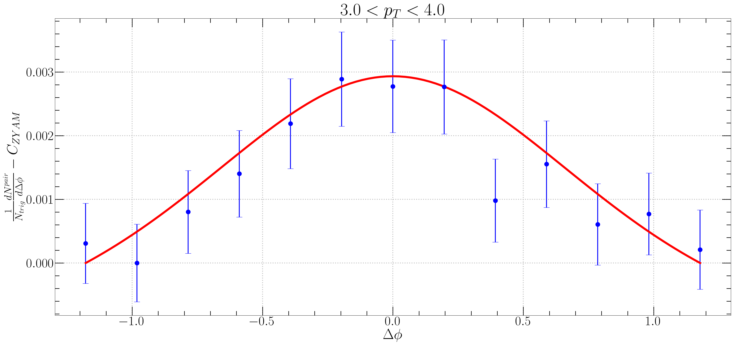


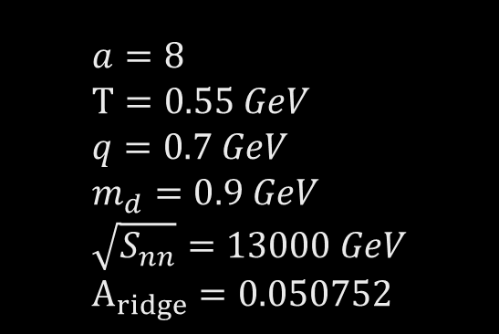
$Δφ$ Correlation Fitting 2
in ALICE
$$a=8 \\ T=0.55 GeV \\ q=0.7 GeV \\ m_{d}=0.9 GeV \\ \sqrt{S_{nn}}=13000 GeV \\ A_{ridge}=0.050752$$
$f_{R}<N_{k}>$ $1<p_{T}<2 →2$ $2<p_{T}<3 →5.5$ $3<p_{T}<4 →15.125$

Slide 6
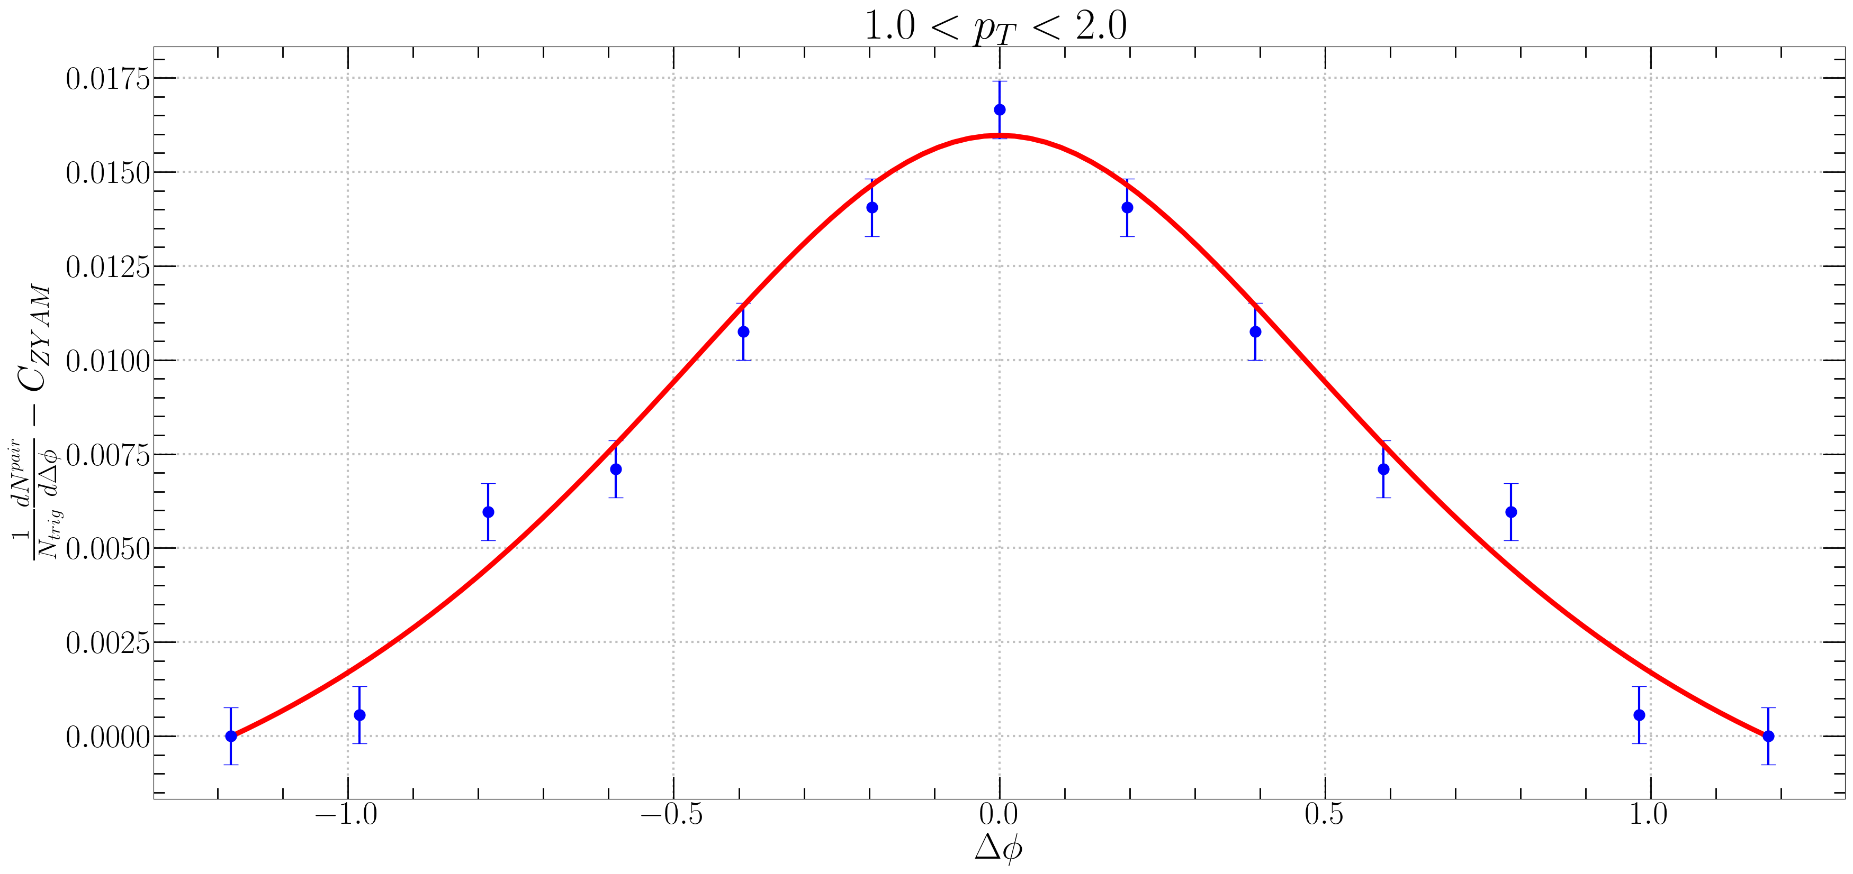
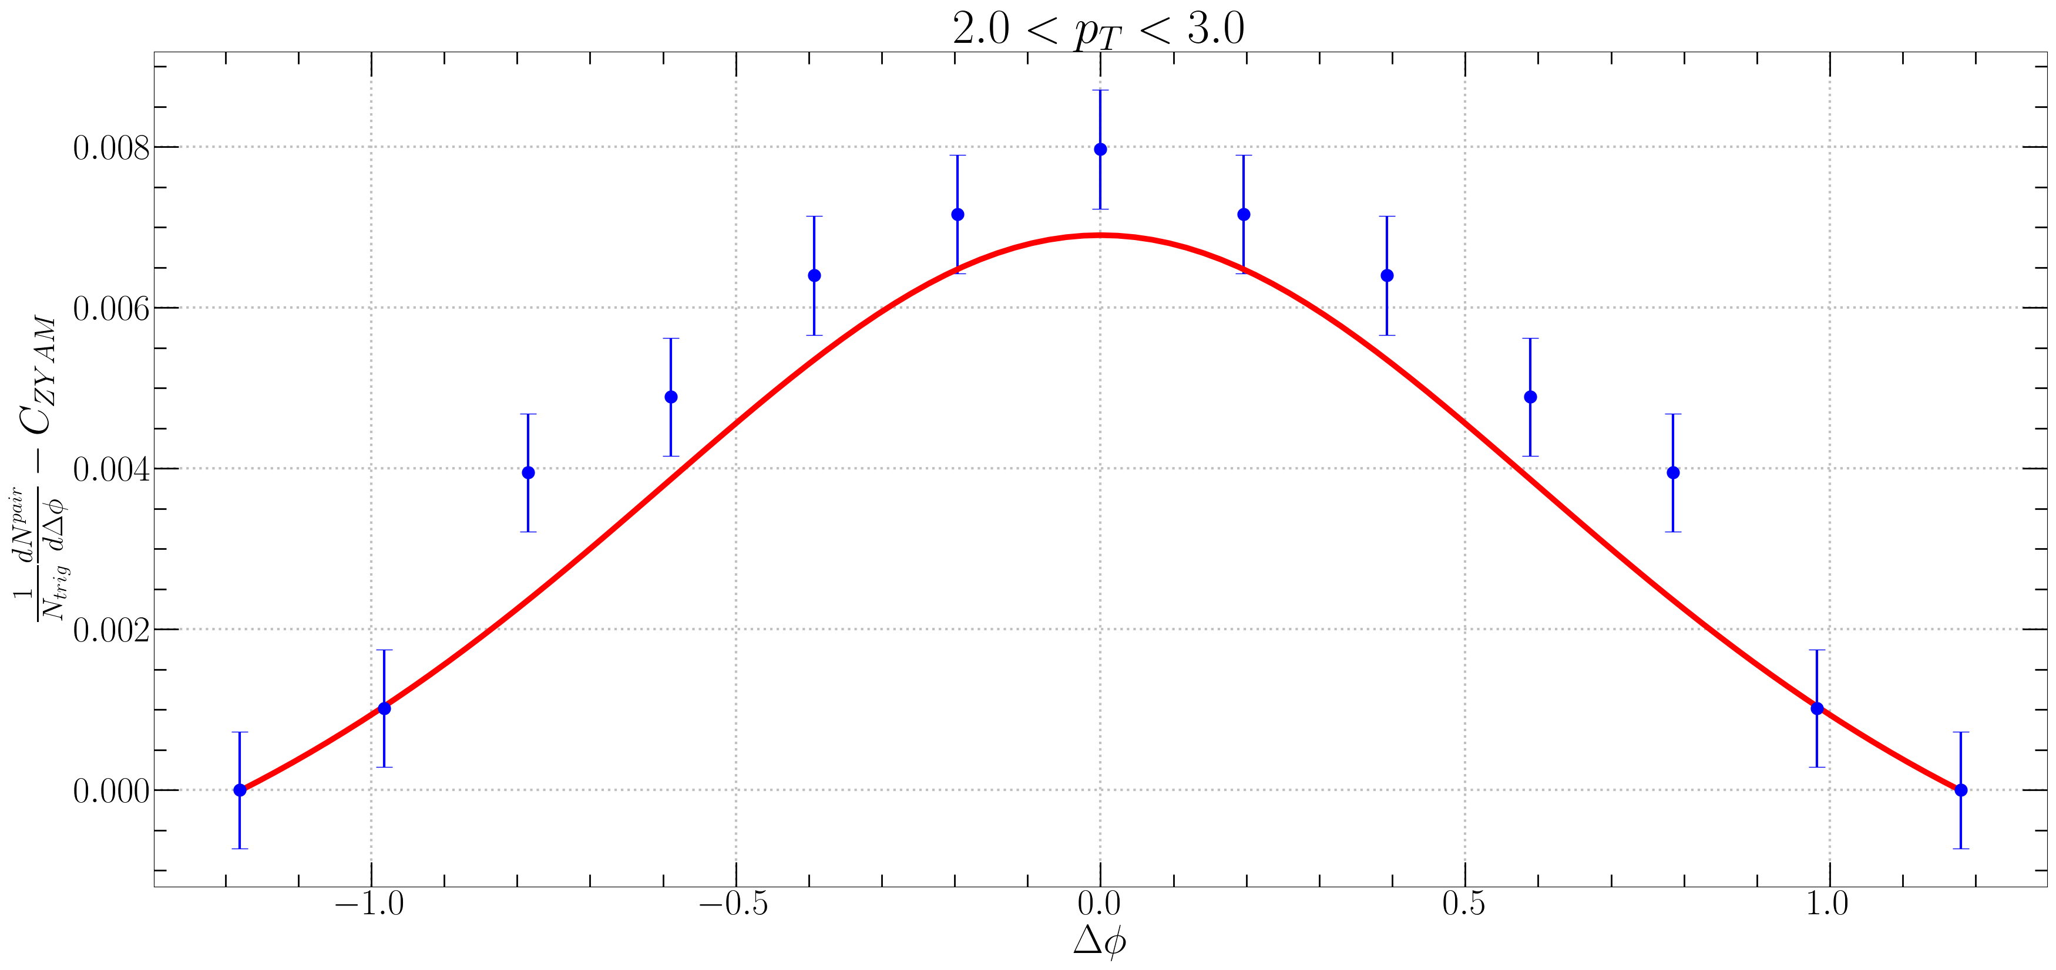
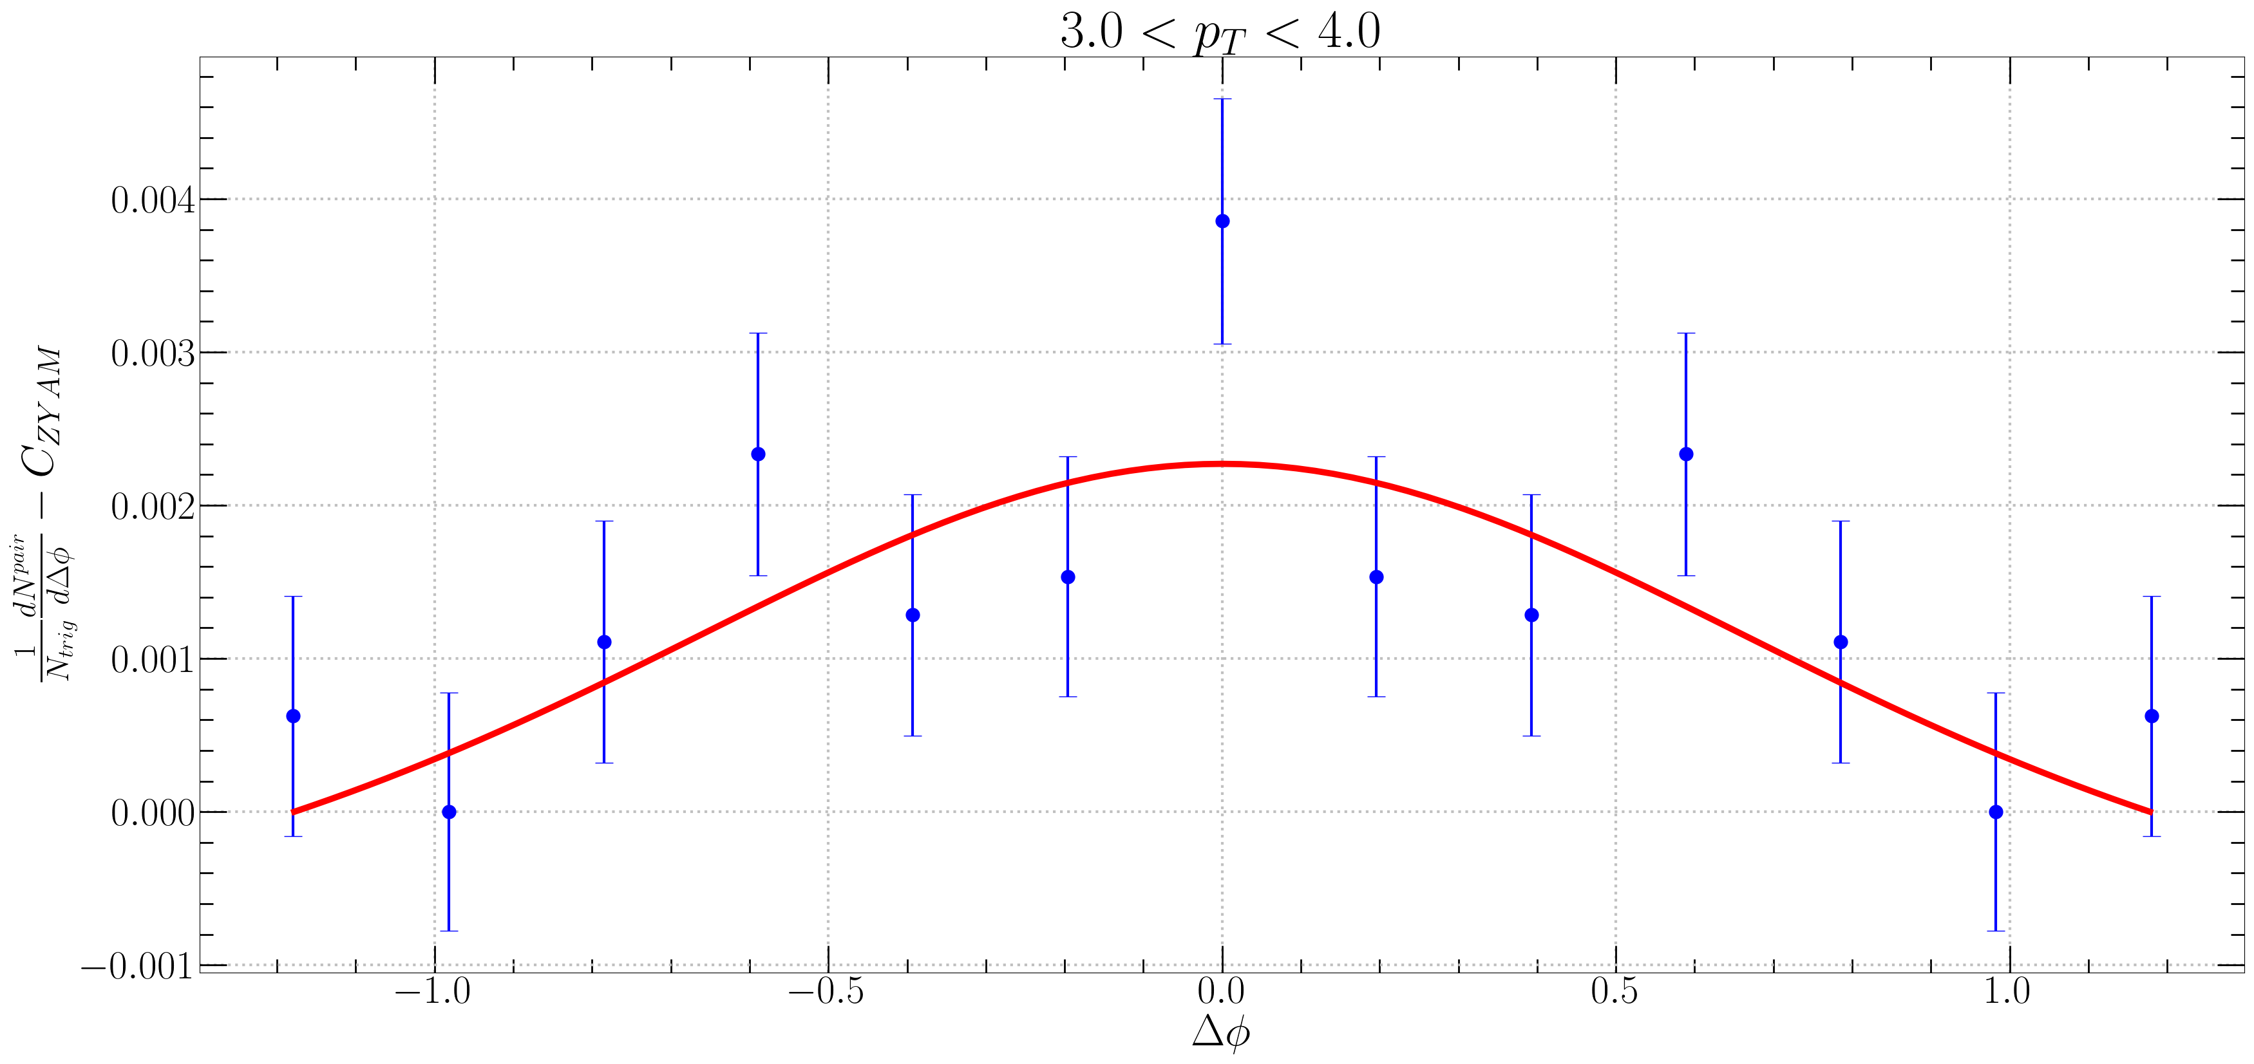
$Δφ$ Correlation Fitting 2
in CMS
$$a=8 \\ T=0.55 GeV \\ q=0.7 GeV \\ m_{d}=0.9 GeV \\ \sqrt{S_{nn}}=13000 GeV \\ A_{ridge}=0.050752$$
$f_{R}<N_{k}>$ $1<p_{T}<2 →2$ $2<p_{T}<3 →5.5$ $3<p_{T}<4 →15.125$

Slide 7

$f_{R}<N_{k}>$ : $1<p_{T}<2 →2, 2<p_{T}<3 →5.5, 3<p_{T}<4 →15.125$
선$형적으로 p_{T} dependence를 넣을 경우 : f_{R}<N_{k}> =3.5p_{T}−3.25$
$0.1<p_{T}<1$에서 $f_{R}<N_{k}>$가 음수가 되어 사용할 수 없음.
$f_{R}<N_{k}> =0.38e^{1.0116p_{T}}$ 를 사용.
$p_{T}=1.5 →f_{R}<N_{k}> ≈1.733$
$p_{T}=2.5 →f_{R}<N_{k}> ≈4.766$
$p_{T}=3.5 →f_{R}<N_{k}> ≈13.11$

Slide 8
7p 하단부
The results are shown for various pT intervals in the minimum bias class (upper) and the high-multiplicity class (lower) down to 1GeV/c where the non-flow contamination is negligible.
1GeV 이하 무시.

Slide 9
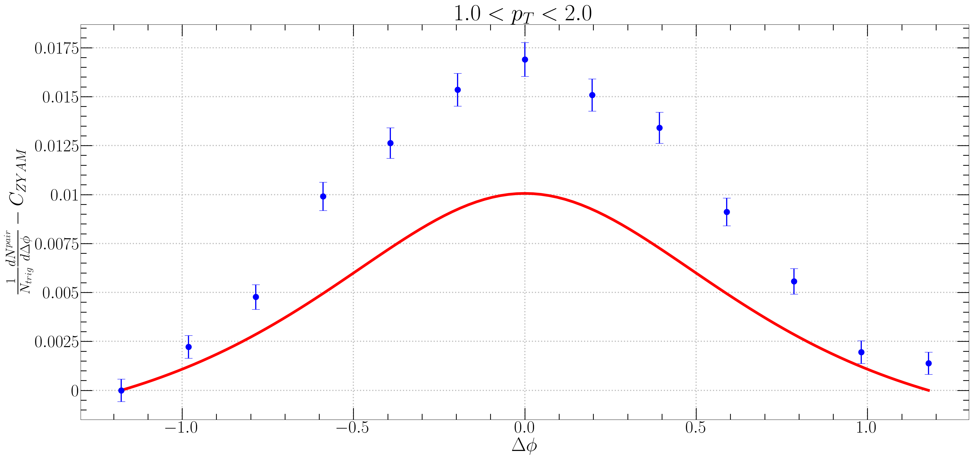
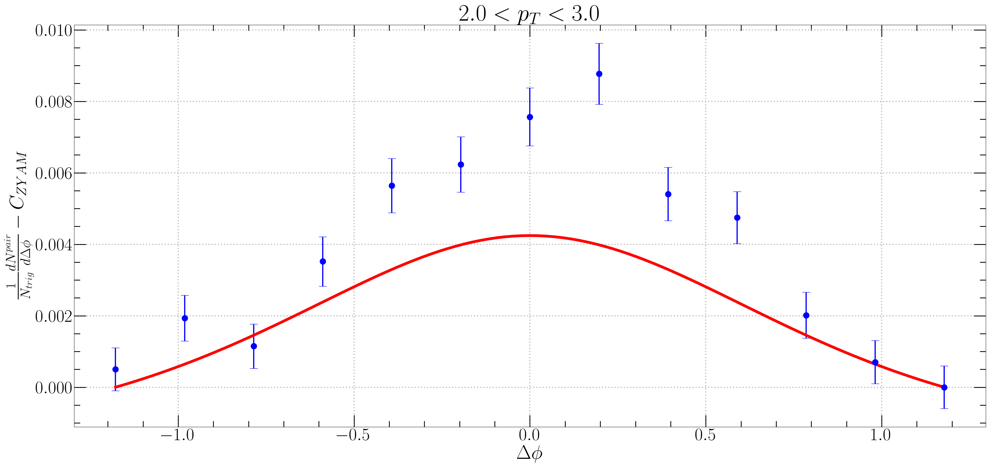
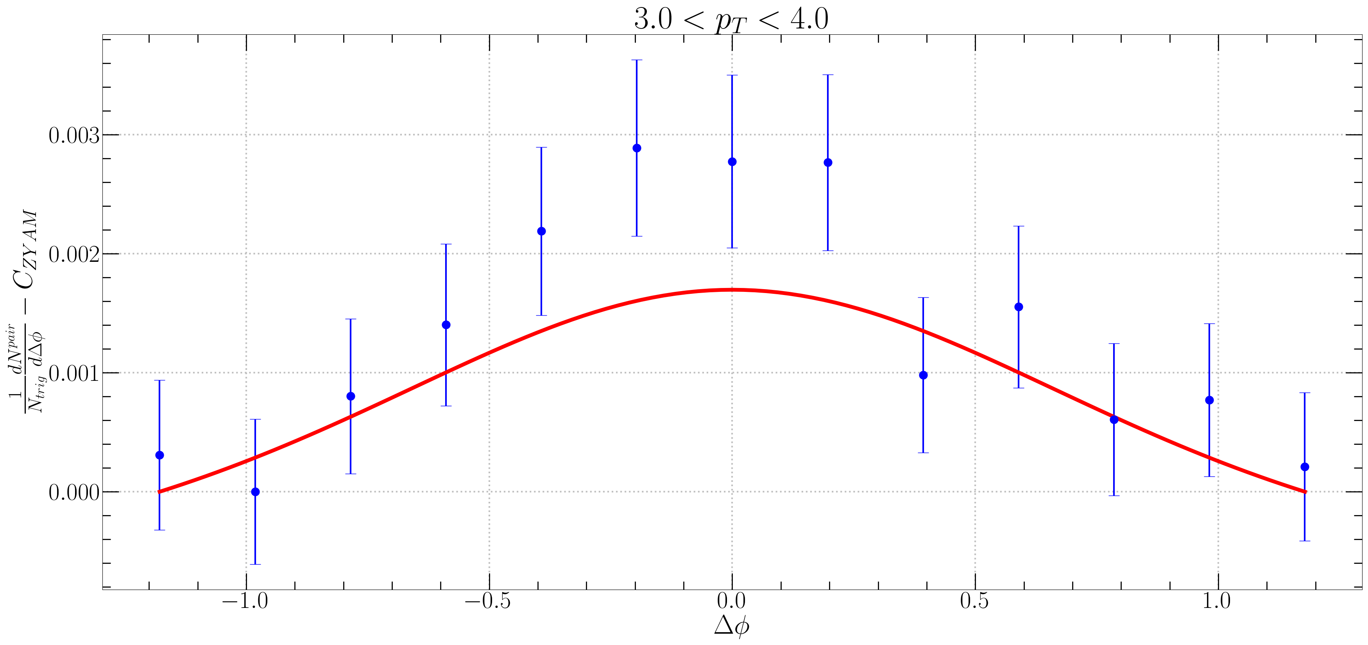

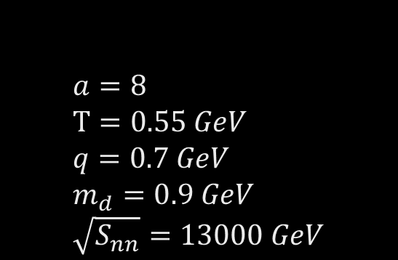

$Δφ$ Correlation Fitting 3
in ALICE
$$a=8 \\ T=0.55 GeV \\ q=0.7 GeV \\ m_{d}=0.9 GeV \\ \sqrt{S_{nn}}=13000 GeV$$
$f_{R}<N_{k}> =0.38e^{1.0116p_{T}}$

Slide 10

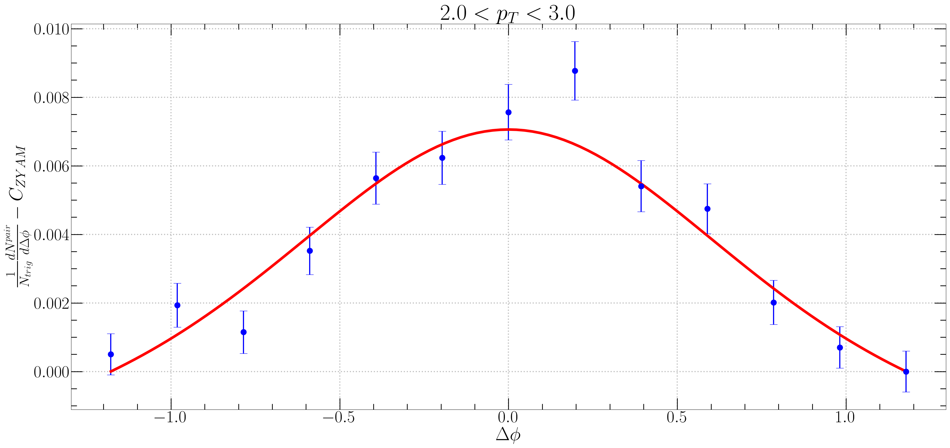
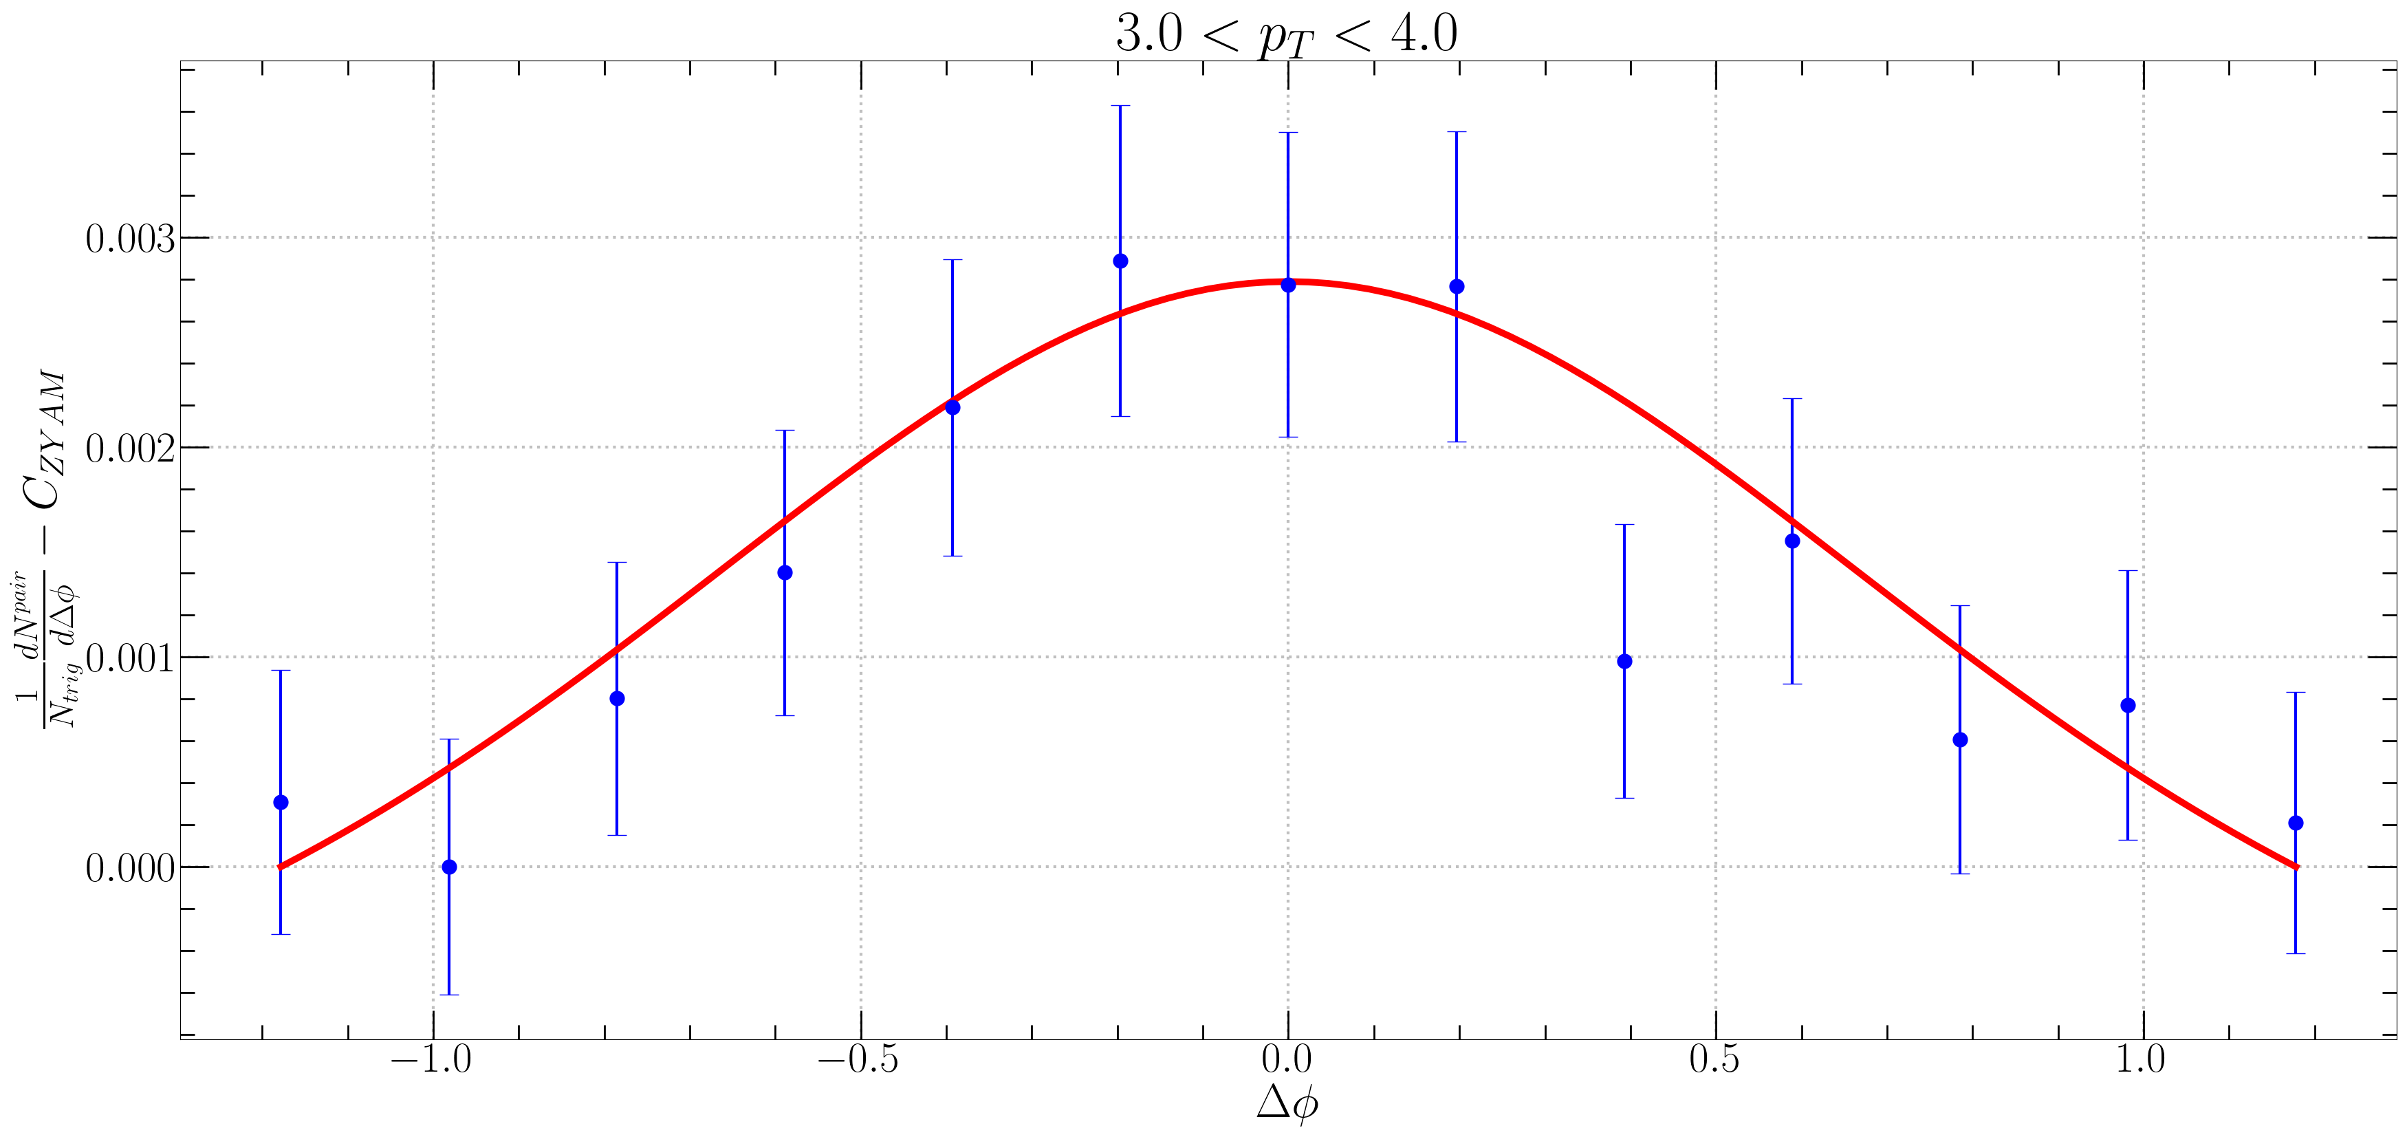


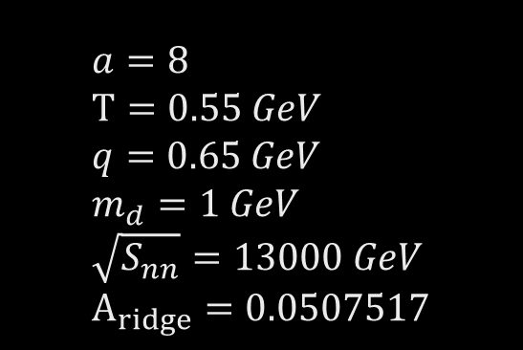
$Δφ$ Correlation Fitting 4
in ALICE
$$a=8 \\ T=0.55 GeV \\ q=0.65 GeV \\ m_{d}=1 GeV \\ \sqrt{S_{nn}}=13000 GeV \\ A_{ridge}=0.0507517$$
$f_{R}<N_{k}> =0.65e^{p_{T}}$

Slide 11
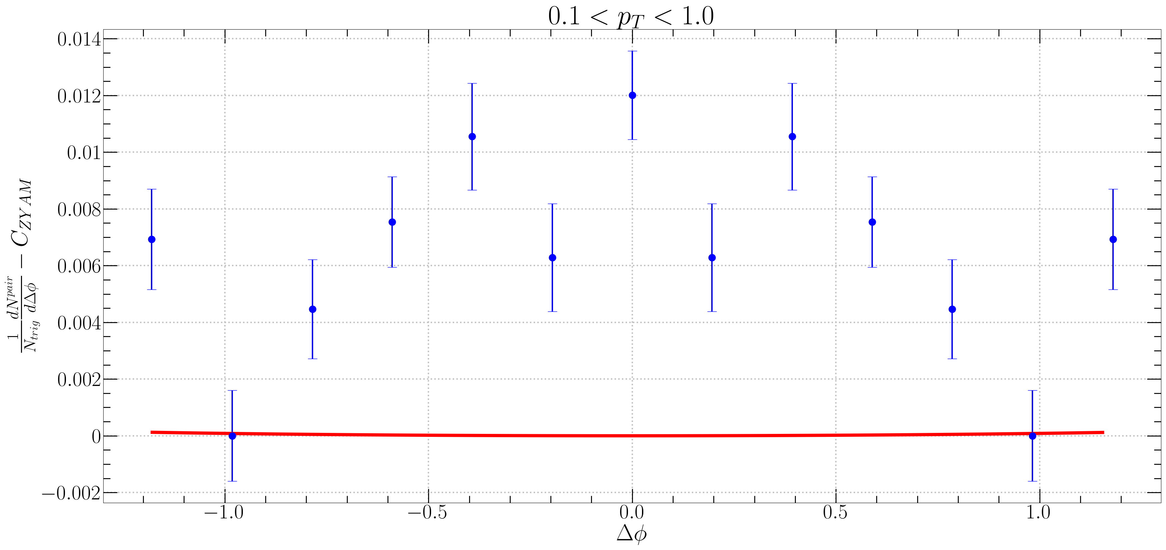
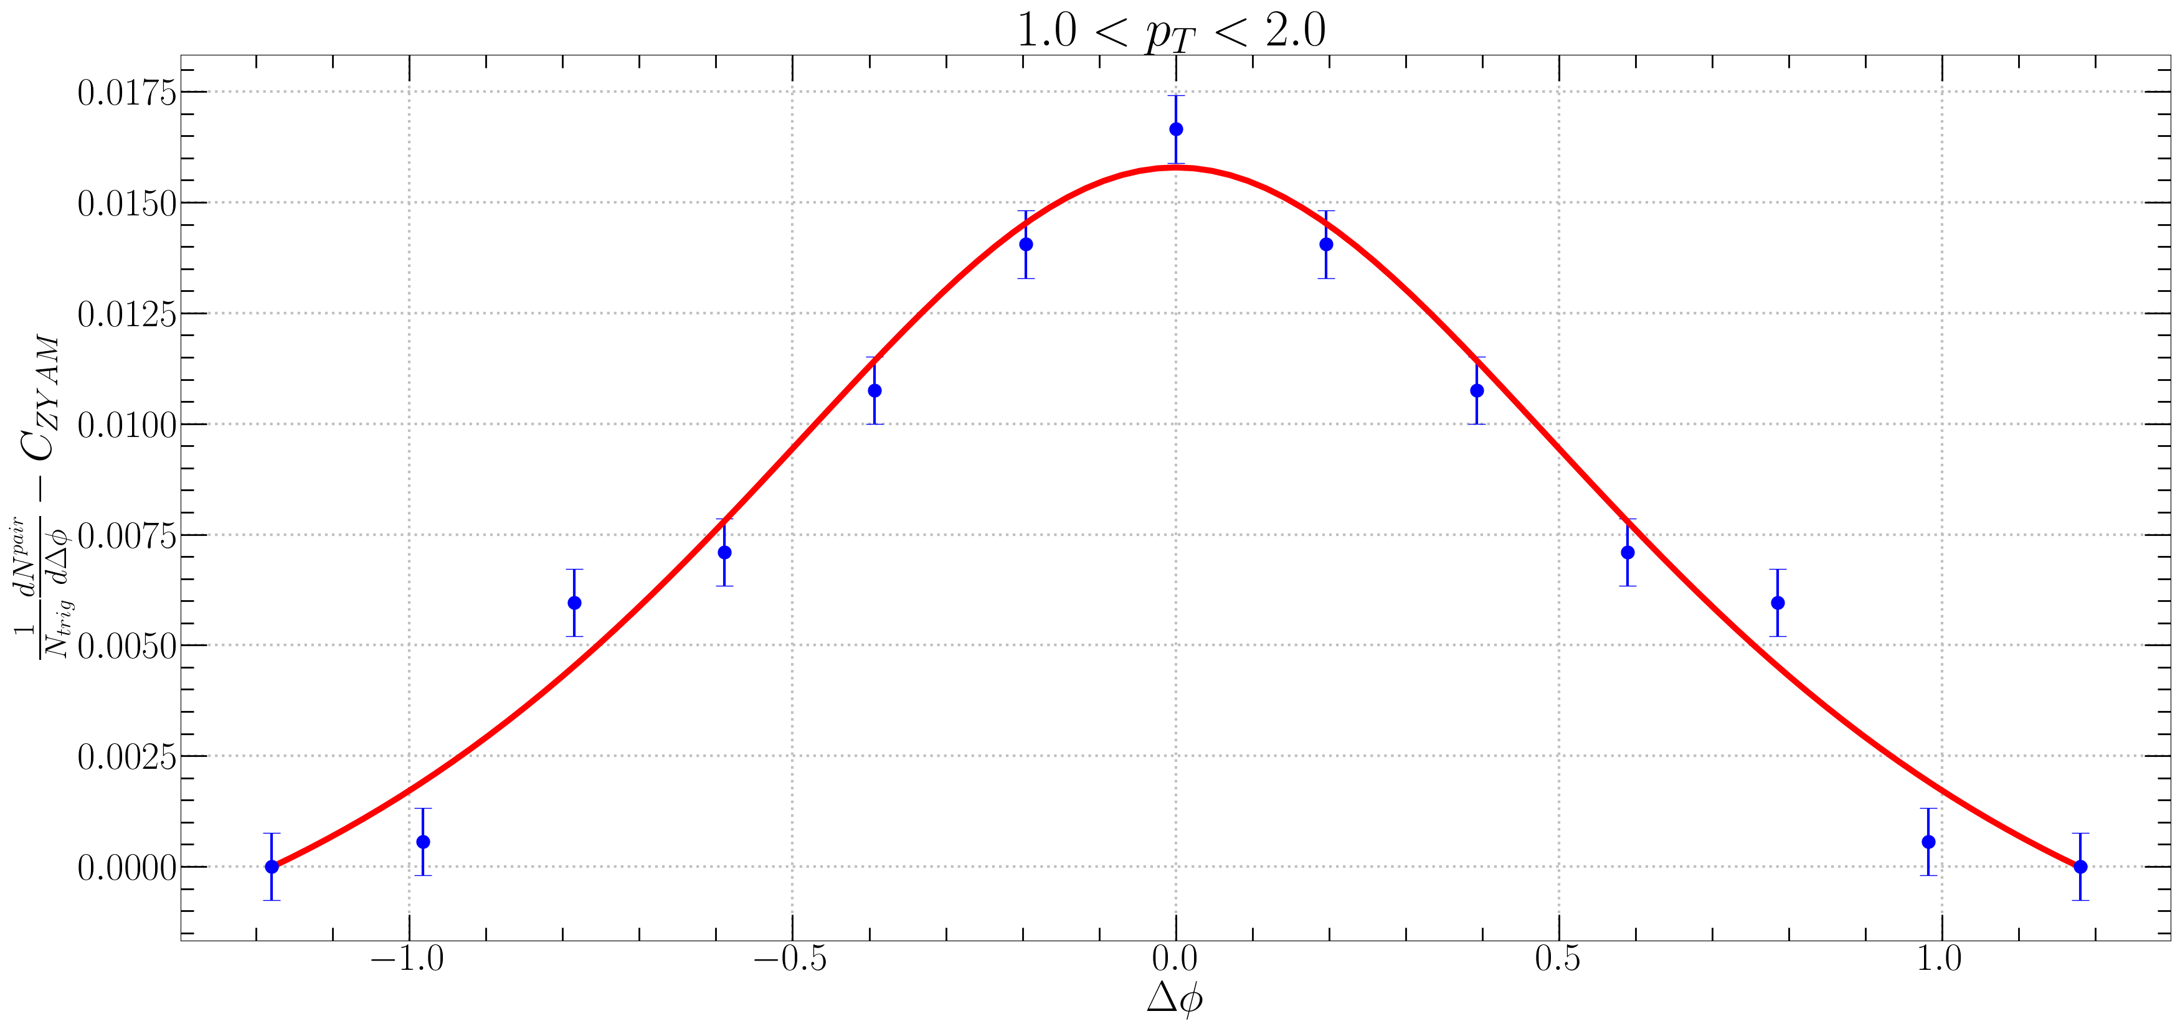
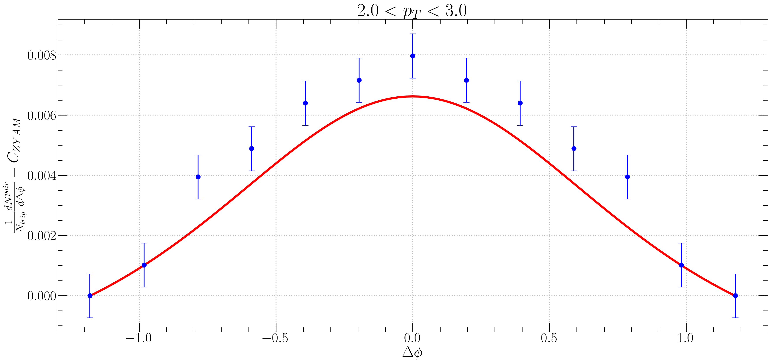
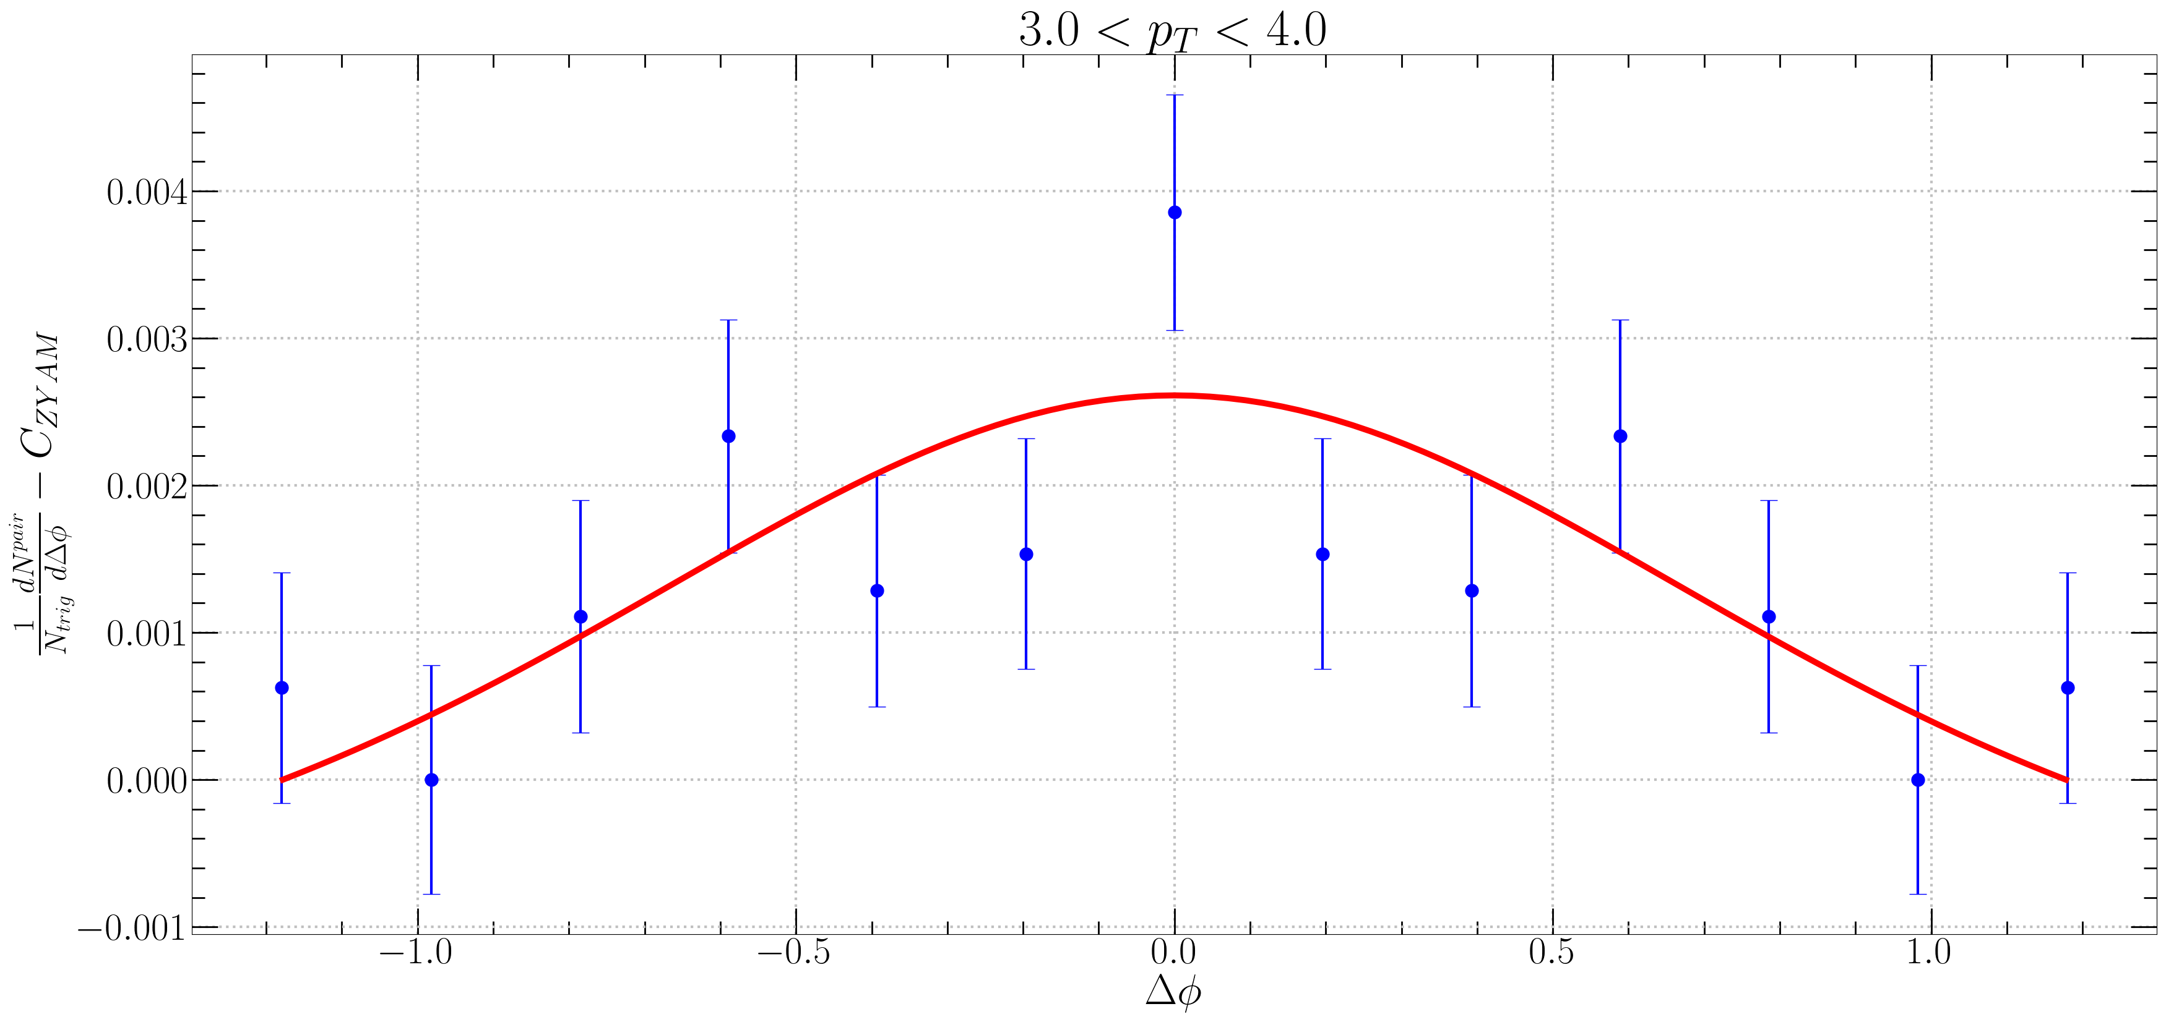
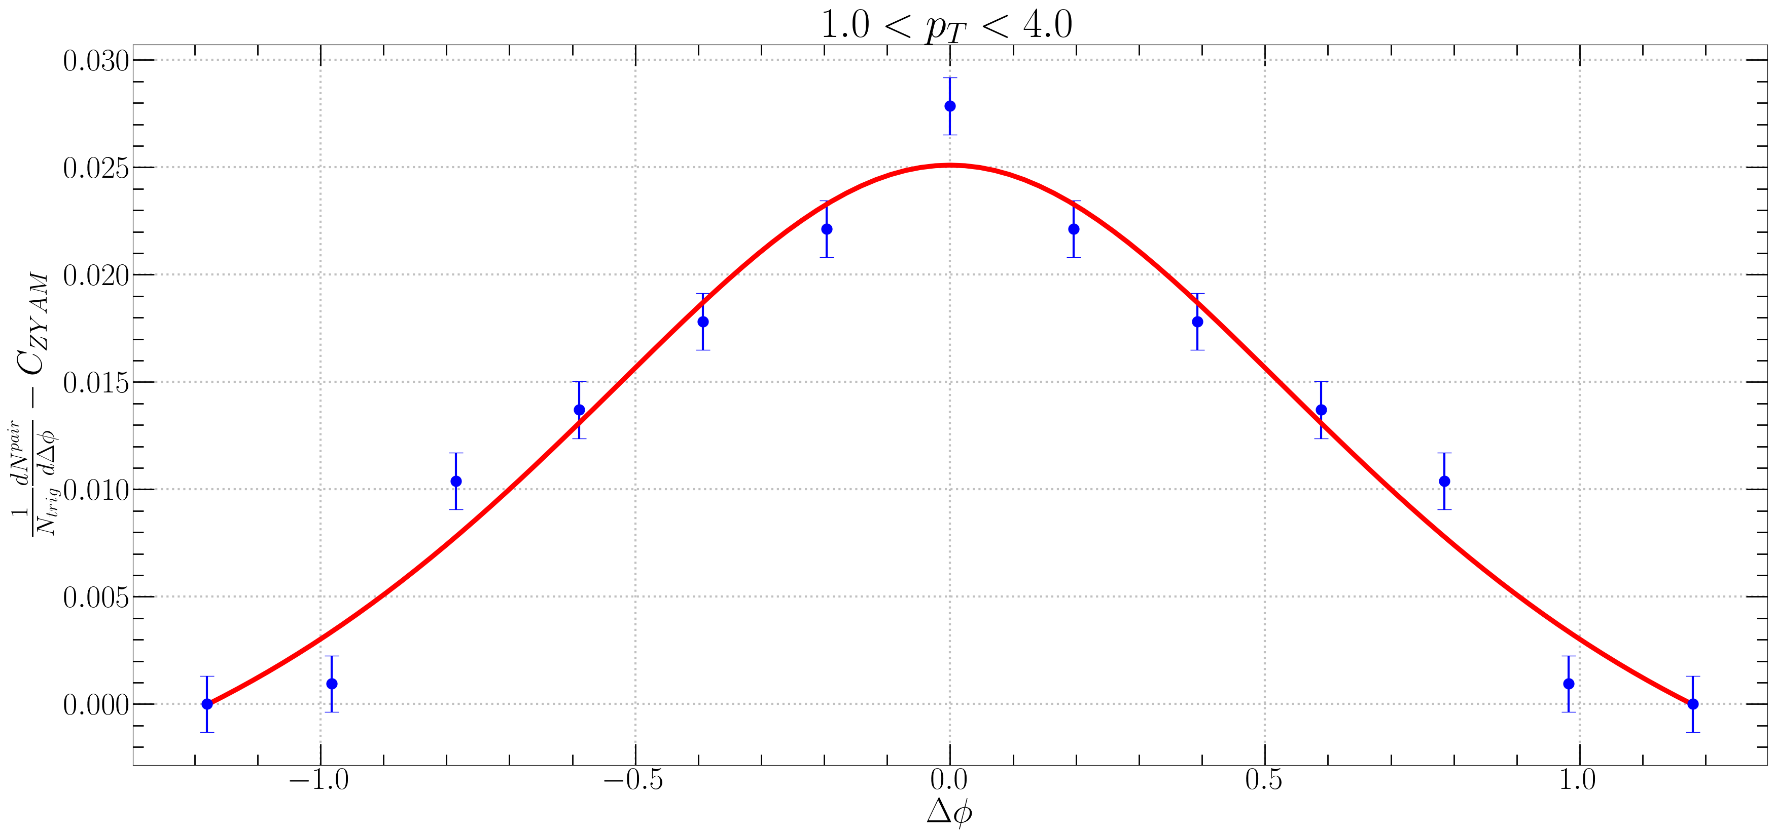

$Δφ$ Correlation Fitting 4 - CMS
그래프가 거의 그려지지 않음.

Slide 12
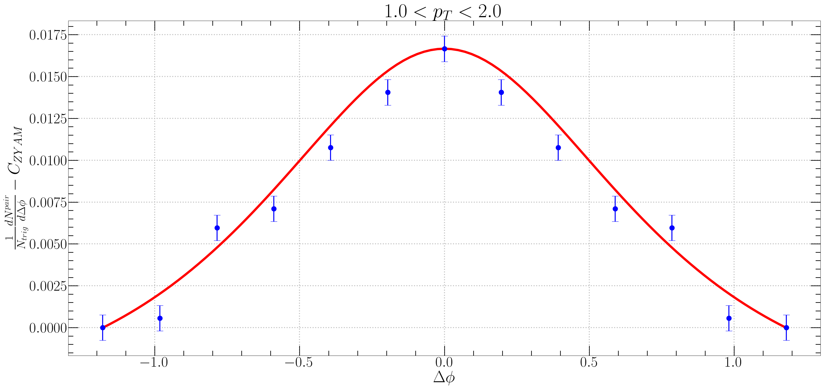
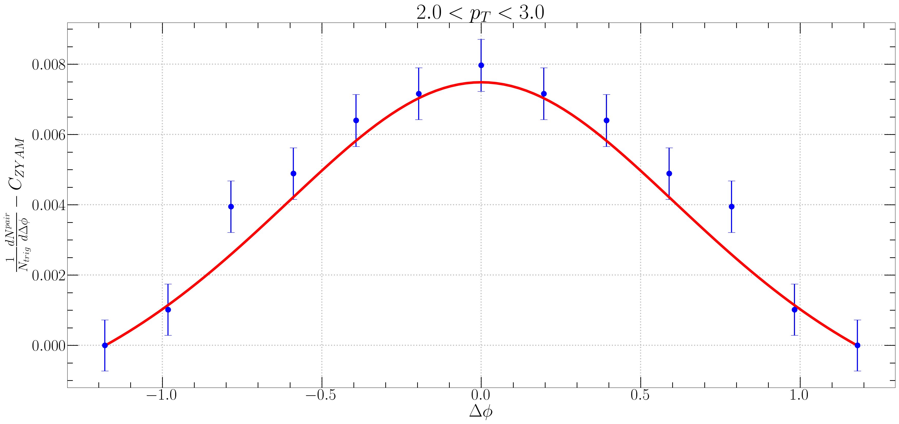
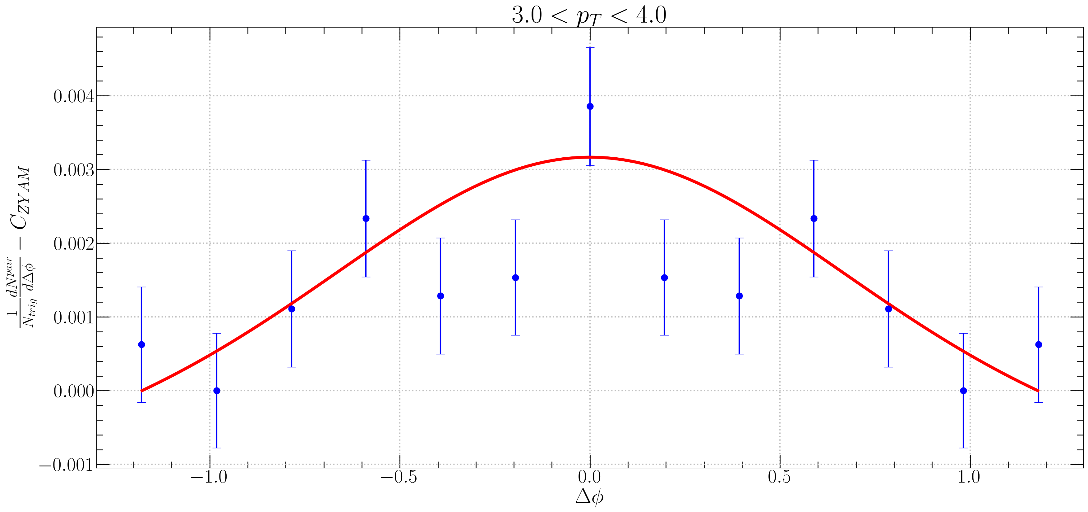
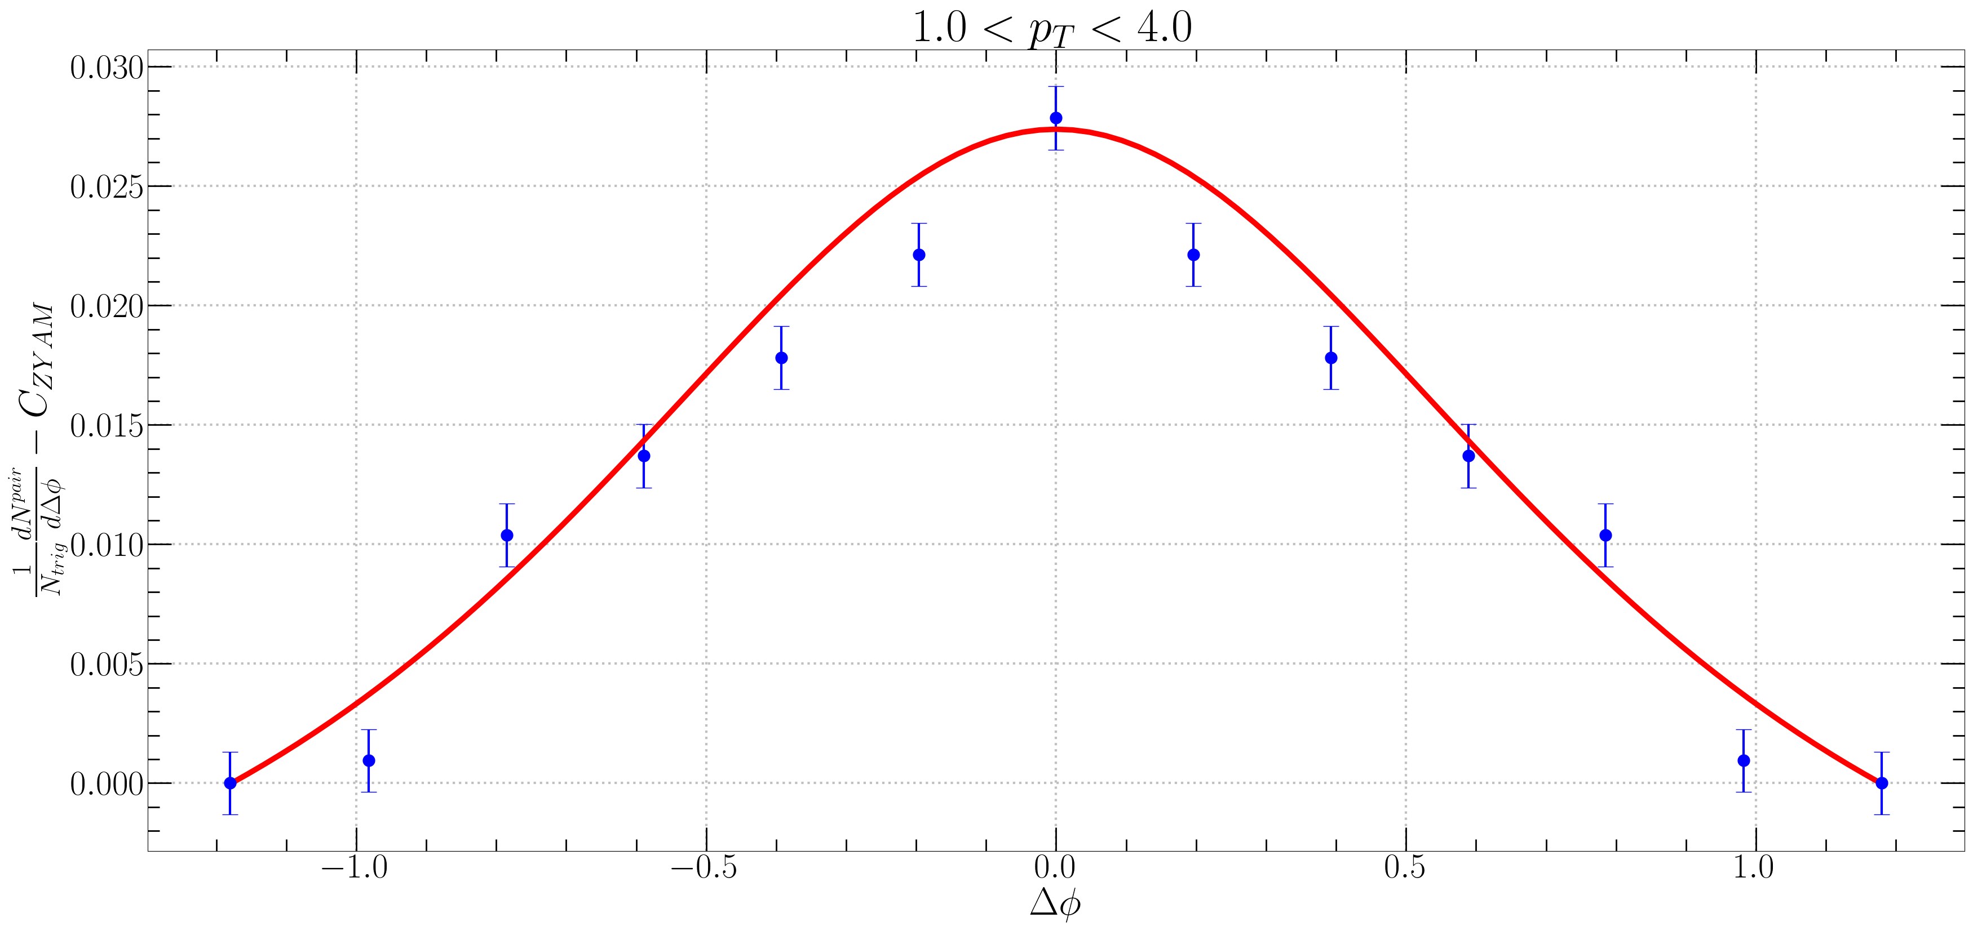

CMS
$f_{R}<N_{k}> =0.65e^{p_{T}} → 0.62e^{1.07p_{T}}$

Slide 13
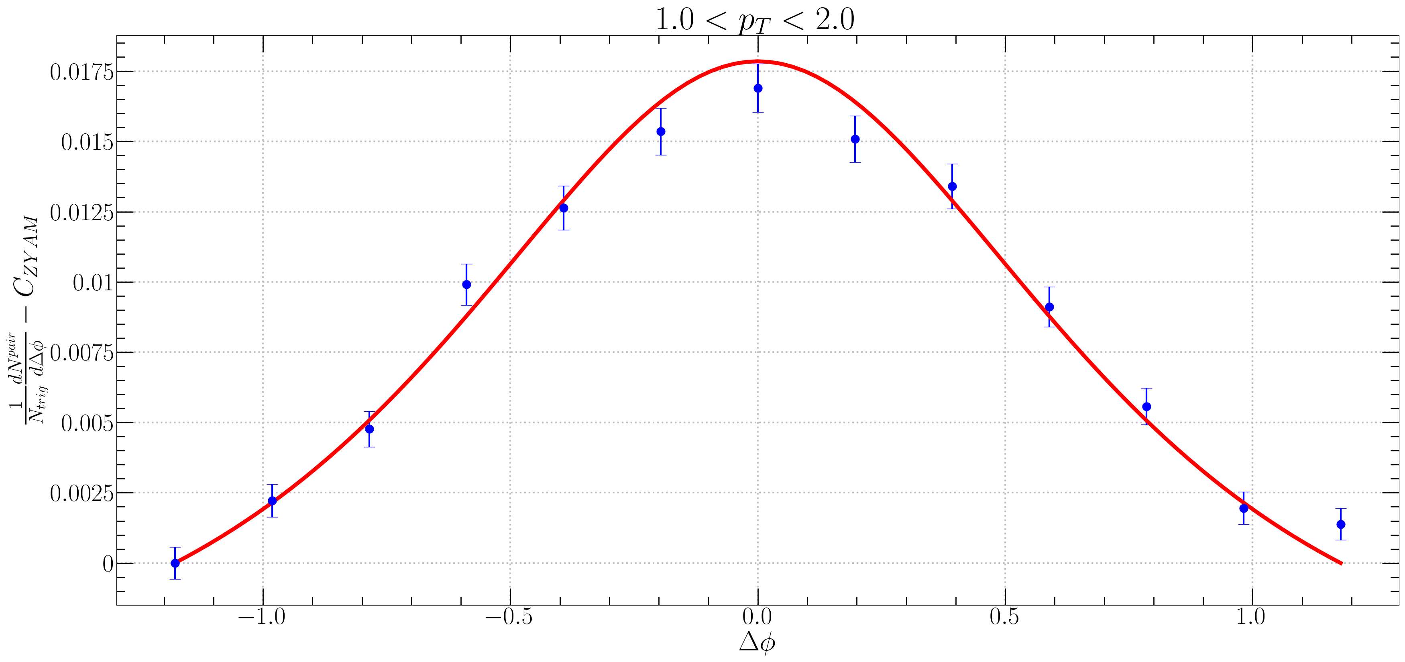
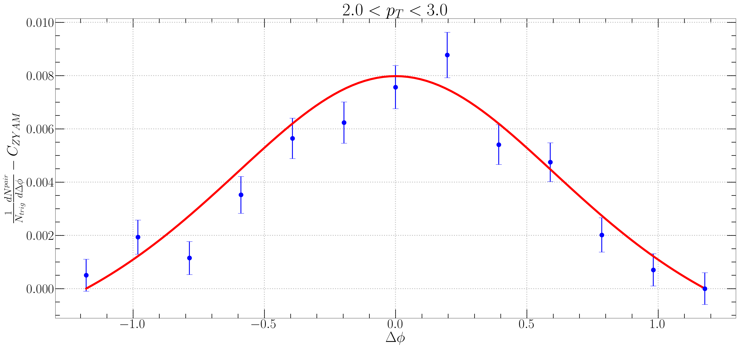
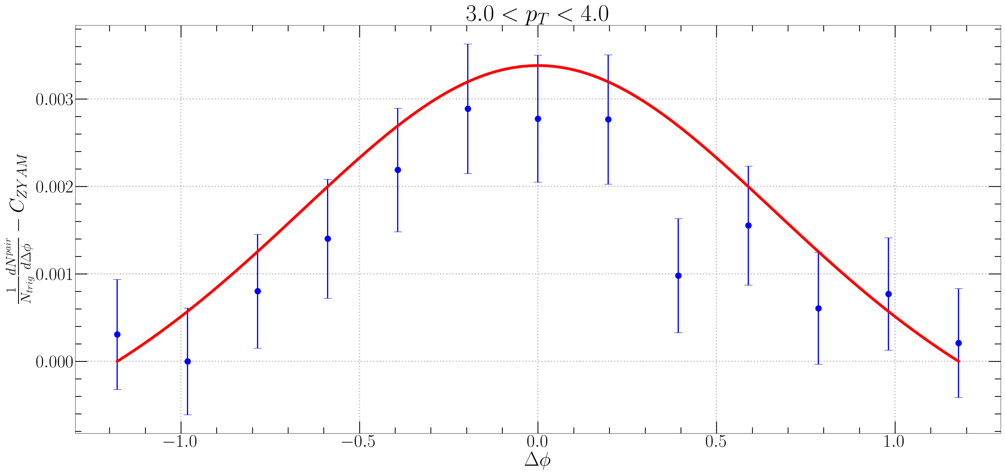
ALICE
$f_{R}<N_{k}> =0.65e^{p_{T}} → 0.62e^{1.07p_{T}}$

Slide 14
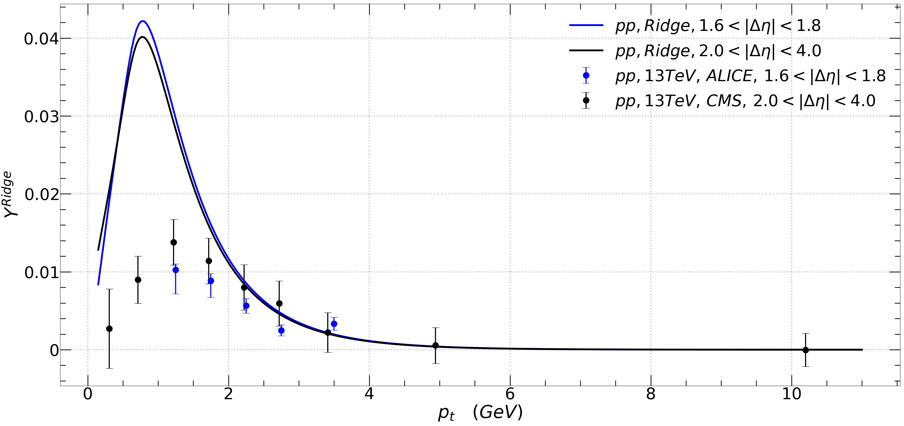

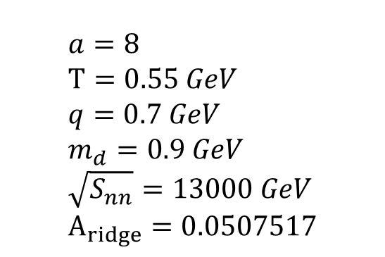

$p_{T}$ Distribution Fitting
$$a=8 \\ T=0.55 GeV \\ q=0.7 GeV \\ m_{d}=0.9 GeV \\ \sqrt{S_{nn}}=13000 GeV \\ A_{ridge}=0.0507517$$
$f_{R}<N_{k}> =0.65e^{p_{T}}$

Slide 15
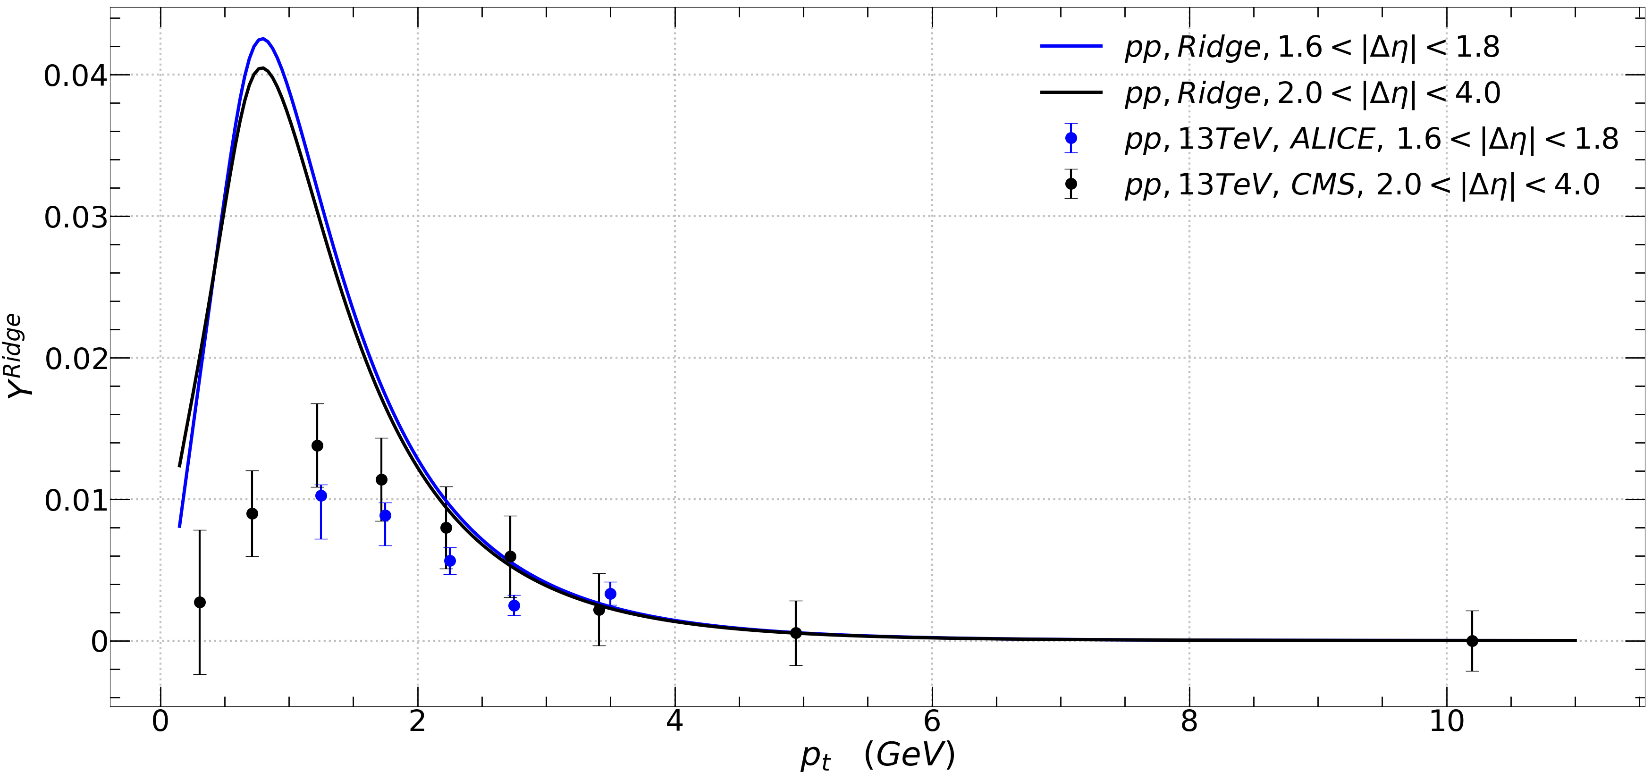


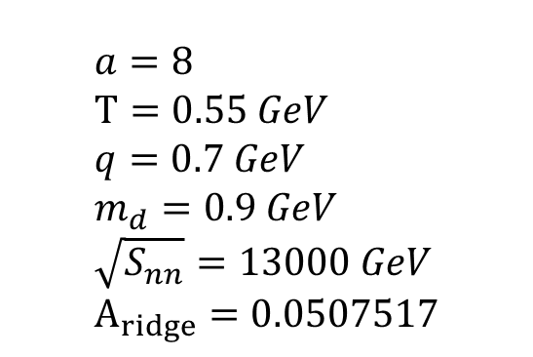
$p_{T}$ Distribution Fitting
$$a=8 \\ T=0.55 GeV \\ q=0.7 GeV \\ m_{d}=0.9 GeV \\ \sqrt{S_{nn}}=13000 GeV \\ A_{ridge}=0.0507517$$
$f_{R}<N_{k}> =0.62e^{1.07p_{T}}$

Slide 16
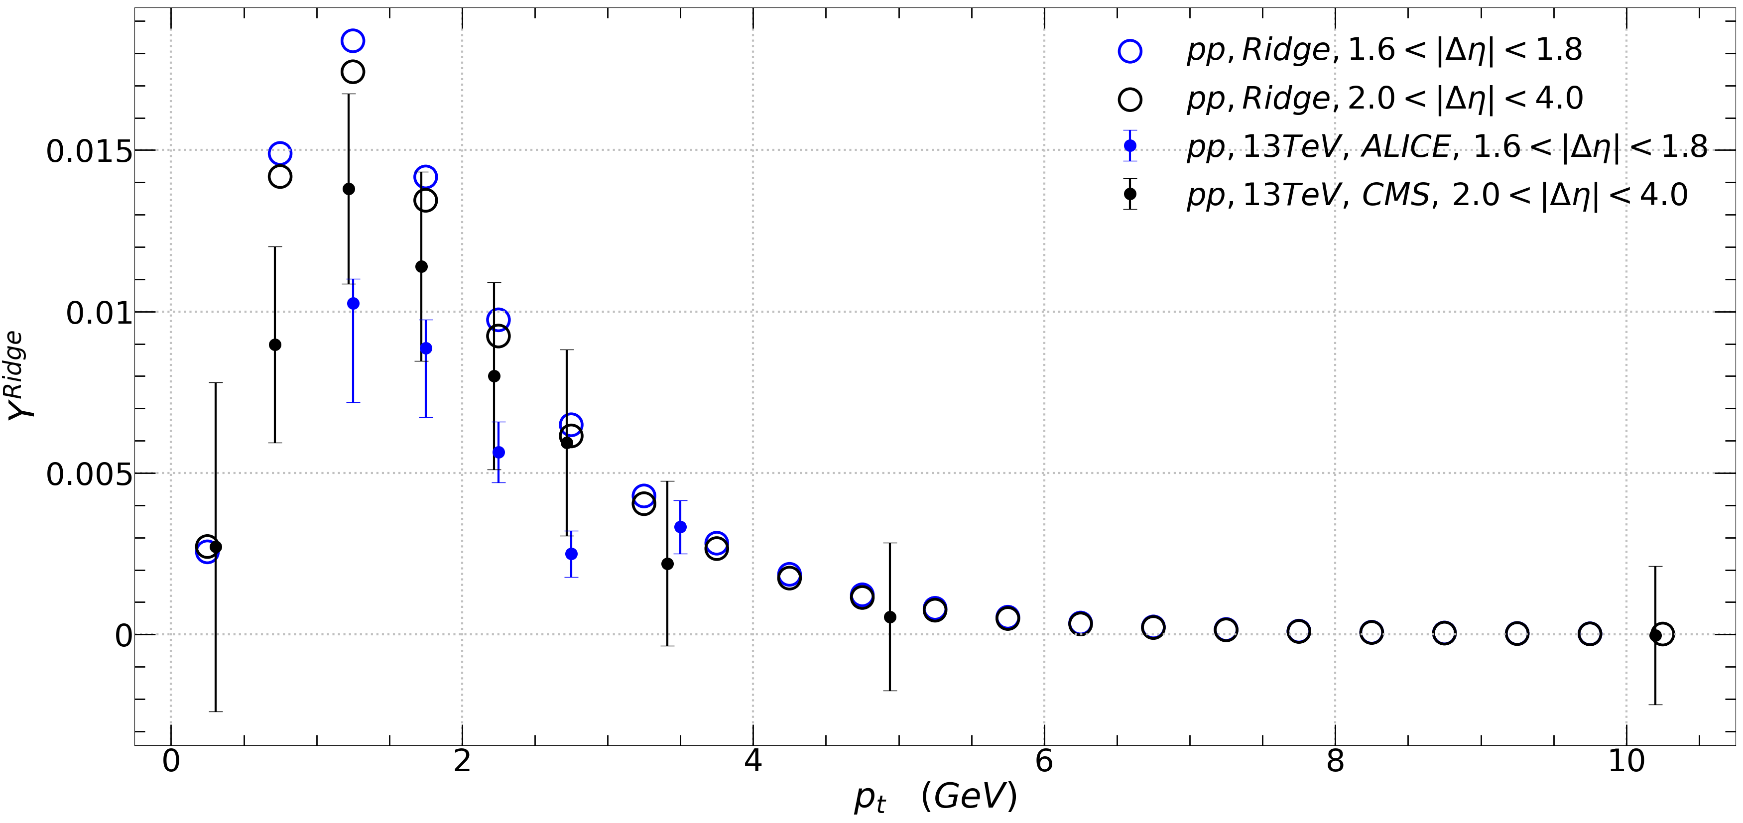


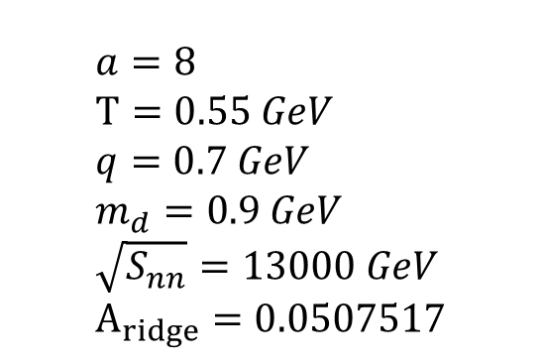
$$Y^{ridge}=\int_{−1.28<\left|Δ φ\right|<1.28}{\left[\int_{1.6<\left|Δ η\right|<1.8}{\left(\int{\frac{d^{2}F}{p_{T}dp_{T}dΔηdΔφ}} p_{T}dp_{T}\right)\frac{1}{δ_{Δη}}dΔη}\right]dΔφ }$$
$$a=8 \\ T=0.55 GeV \\ q=0.7 GeV \\ m_{d}=0.9 GeV \\ \sqrt{S_{nn}}=13000 GeV \\ A_{ridge}=0.0507517$$
$f_{R}<N_{k}> =0.62e^{1.07p_{T}}$

